Slide 1

Capstone Project Report On
“TRAVEL APPROVAL APP”
BY:
Name: Botta Naveen
Batch: WIP-SF-13
LMS Id: MGSA_523

Slide 2
Content
INTRODUCTION TO SALESFORCE
INTRODUCTION OF TRAVEL APPROVAL APP
MODULE 1
MODULE 2
MODULE 3

Slide 3
INTRODUCTION TO SALESFORCE
What is salesforce?
Why do we use salesforce?
What does Salesforce do?
What are the benefits of Salesforce ?
Notes:
Customer 360 Truth helps you build a complete view of your customers and deliver to them the seamless experiences that they expect. It’s a family of products that helps you understand your customer and that’s needed today.
Customer 360 Data Manager helps customers build their single source of truth by connecting customer data across Salesforce clouds, orgs, and non-Salesforce systems while matching that data to an individual to create a common profile and issue a single Salesforce ID for each person. This common profile and Salesforce ID enables a single view of your customer across systems, reducing integration costs and empowering companies to deliver connected and personalized experiences for their customers on the worlds #1 CRM.
Salesforce Identity for Customers ensures that the end customer experience is free from friction due to tedious logins. It gives you the ability to provide authenticated logins across all of your digital properties.
Customer 360 Audiences helps you build unified customer profiles, engage across enterprise channels, and measure performance. It enables you to ingest petabytes of data - which is truly consumer-scale - with built-in connectors. Using AI, it segments this huge amount of data and delivers helpful insights and segmentation. In short, it’s the piece of our capabilities to help you build out the profiles you need to engage personally on every channel and touchpoint.
Salesforce Privacy and Data Governance enables you to collect and respect your customers data use and privacy preference as well as apply data classification labels to all of your data in Salesforce. This means you can know what kind of data you have, what uses of data your customers are okay with, and how best to interact with them. These capabilities help customers address obligations from regulations such as GDPR and CCPA with respect to data governance and customer consent.

Slide 4
Introduction to Salesforce
Salesforce is a cloud-based customer relationship management (CRM) platform that allows businesses to manage their customer relationships and sales processes. It provides a wide range of tools and features that enable businesses to streamline their sales processes, automate their workflows, and gain insights into their customer base.
Notes:
how can you solve this problem if you have no single system of truth?

Slide 5
Why we use Salesforce ?
Centralized Customer Data
Improved Sales Process
Marketing Automation
Enhanced Customer Support
Mobile Accessibility
Integration with Other Tools
Overall, Salesforce provides a comprehensive platform for managing customer relationships, improving sales processes, and driving business growth.
Notes:
Today’s customer has expectations that are set by Trailblazing companies who are setting new bars constantly. Think about the experiences you have every day:
Amazon has set the bar for unified digital experiences. I expect that no matter where I engage, I will have a single login. I won’t have to deal with multiple logins to make an order, get service, post a review, or use the various apps from Amazon. It makes my experience with Amazon free from friction.
Starbucks is defining personalized engagement. They engage me in a way that demonstrates they truly know my preferences, my past behaviors, and how I like to be engaged. Starbucks makes my life easier by taking into account all that I’ve done and using that to make what I do next that much quicker.
And, Marriott is fostering loyalty with every interaction. They do it by making sure that everyone I talk to: reservations, a Bonvoy rep, two-way chat, on premise staff, anyone, knows me. Marriott employees know who I am regardless of touchpoint.
Customers now expect unified digital experiences, personalized engagement and informed interactions.
But, most experiences don’t meet these expectations.

Slide 6
Travel Approval App
Travel approval app for Salesforce that streamlines the process of requesting and approving business travel requests. The app allows employees to easily submit travel requests through Salesforce, which are then automatically routed to their manager for approval. Managers can review and approve requests in real-time, as well as track the travel expenses and budgets associated with each trip. The app is designed to improve the efficiency of the travel approval process, reduce errors and delays, and provide greater visibility and control over travel expenses. Overall, the travel approval app for Salesforce is a valuable tool for any organization looking to streamline their travel request process and better manage their travel expenses.

Slide 7

Module 1 Build, Create, Import, Test This project module focuses on the non-coding approach to modifying the user interface, as you customize an app that tracks company travel

Slide 8
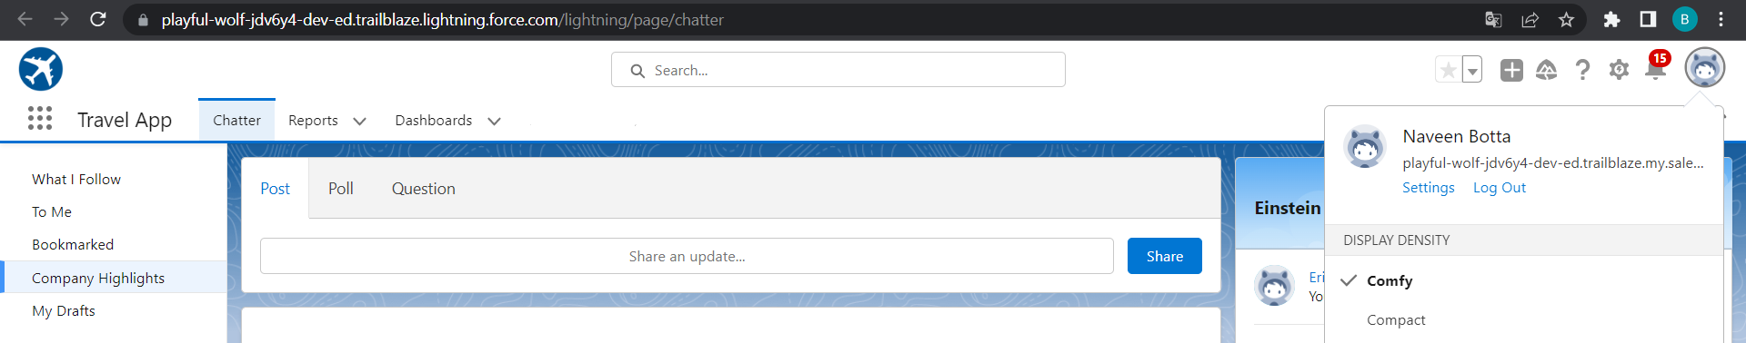
Travel Approval App
Notes:
Key Messages
- Helps our customers deliver a unified customer experience by making our products for B2C Service and Commerce and multiple Service Cloud orgs work together more seamlessly.
- Gives Admins a central place and a click based UI to build connectivity across the apps in a trusted and secure environment
- Builds an ID that is the foundation of connected experiences
- Powers cross-channel experiences that are delivered in pre-built packages in Service and Commerce
- Custom experiences can be built to connect multiple orgs. in Lightning Platform around individual contacts or person accounts
Talk Track
Customer 360 Data Manager gives you one place to centrally establish trusted, secure connectivity across your Salesforce applications. We’re doing away with point to point connectivity and giving you a central hub with a click based UI to manage how apps connect and the data management tools necessary to power connected experience. In the Customer 360 Data Manager you’ll find a robust set of functionality that takes data from the connected systems and creates a single ID for individuals and an accurate, up to date Contact Profile. With point and click ease, Admins will enable new, cross-channel experiences like surfacing data right from Commerce Cloud B2C into an Agent Console in Service Cloud.

Slide 9
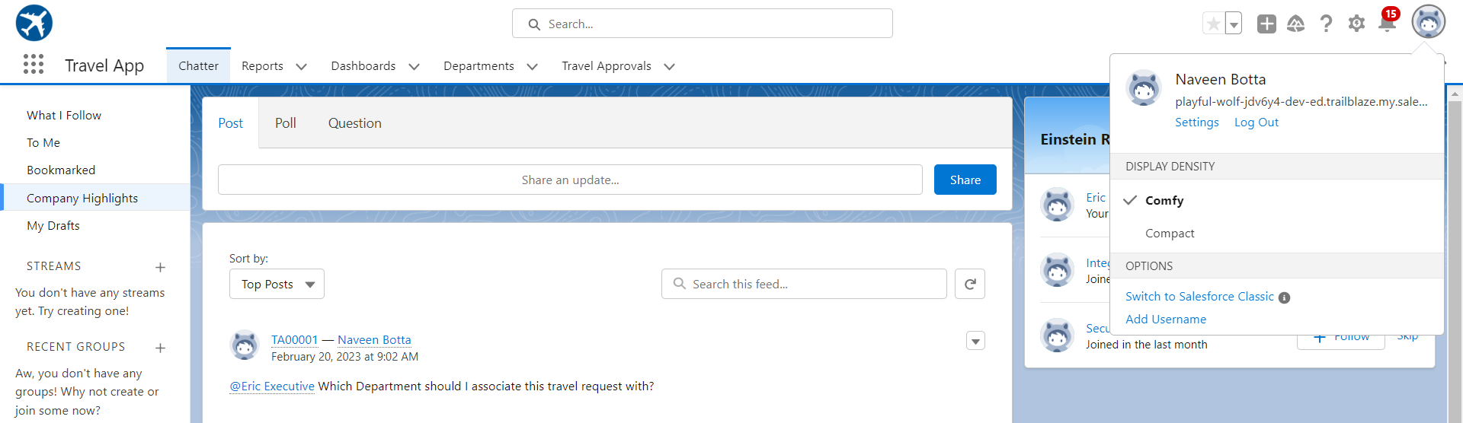
Travel App after adding Custom Objects and Fields
Notes:
Key Messages
Designed to be Application Agnostic allowing multiple data systems to be mapped to it. Map individual systems to the CIM
Subject Areas for the data model are related to an individual. The party – Account & Contact, Payment, Method, Products, Sales Order and Shipment
The CIM covers the subjects
Open Source – Owned by the Linux Foundation – The model is not controlled by just one company

Slide 10
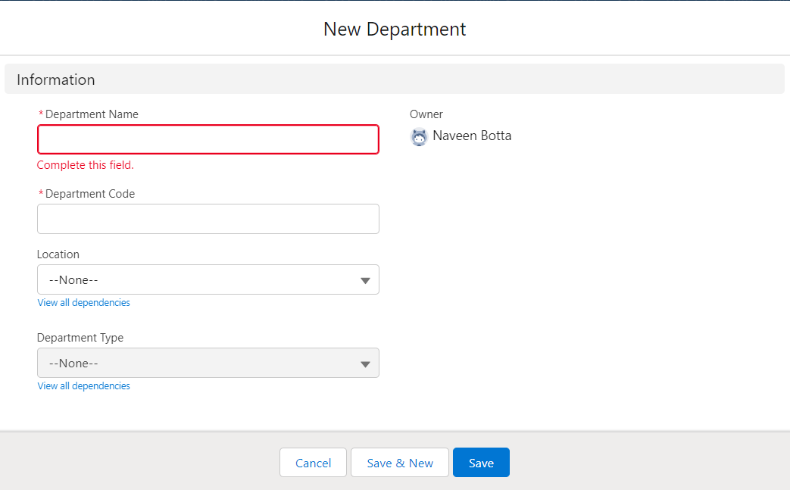
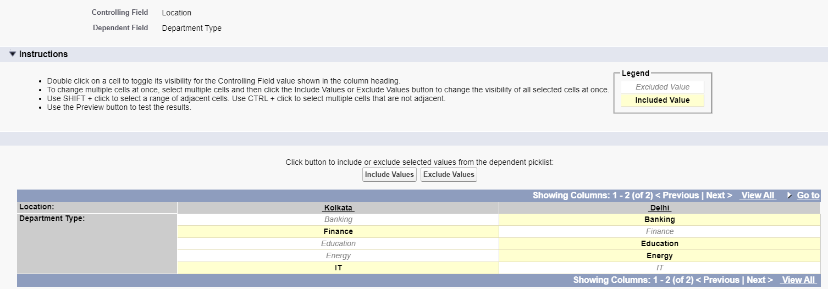
Custom Object with fields
Department sObject with Fields
Notes:
Key Messages
Designed to be Application Agnostic allowing multiple data systems to be mapped to it. Map individual systems to the CIM
Subject Areas for the data model are related to an individual. The party – Account & Contact, Payment, Method, Products, Sales Order and Shipment
The CIM covers the subjects
Open Source – Owned by the Linux Foundation – The model is not controlled by just one company

Slide 11
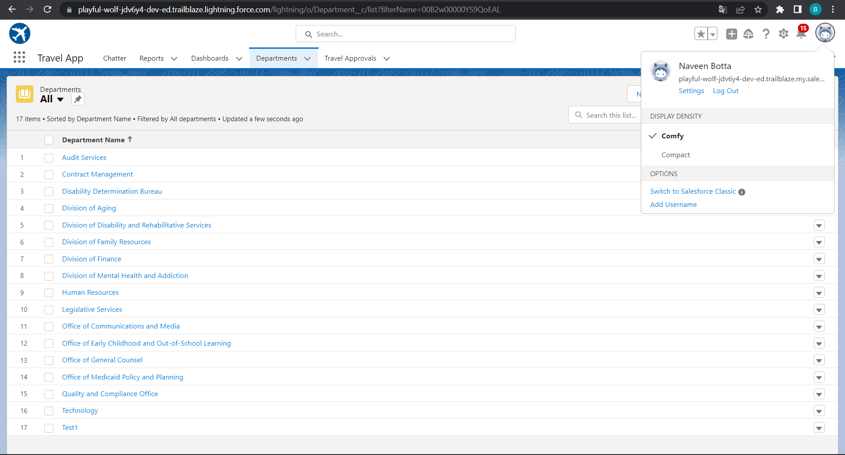
Importing Department records using data import wizard and imported record data status can viewed below
Notes:
Key Messages
Designed to be Application Agnostic allowing multiple data systems to be mapped to it. Map individual systems to the CIM
Subject Areas for the data model are related to an individual. The party – Account & Contact, Payment, Method, Products, Sales Order and Shipment
The CIM covers the subjects
Open Source – Owned by the Linux Foundation – The model is not controlled by just one company

Slide 12
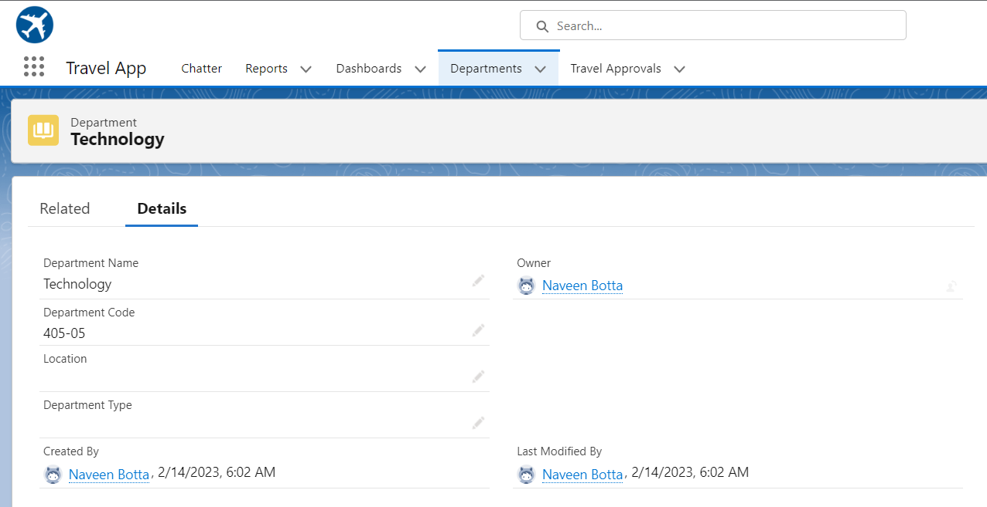
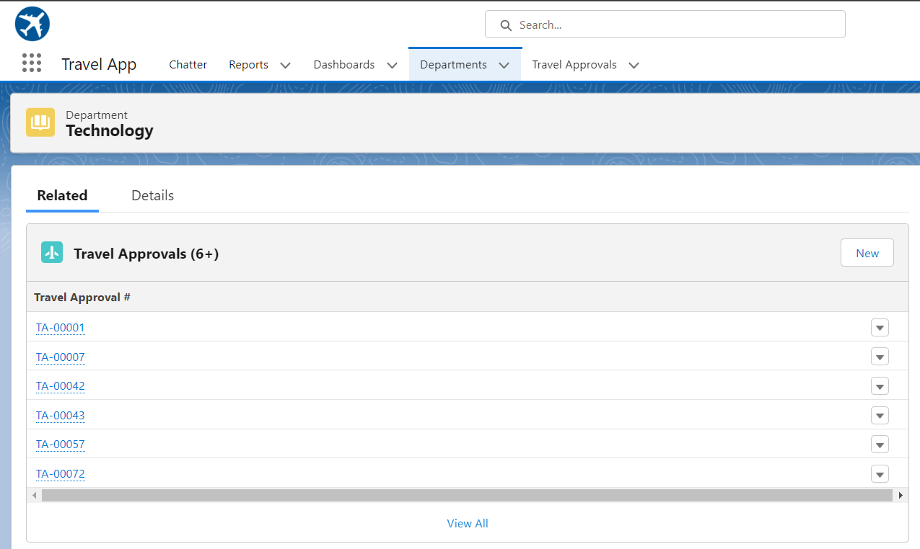
Department record with related travel approval record
Notes:
Key Messages
- Helps our customers deliver a unified customer experience by making our products for B2C Service and Commerce and multiple Service Cloud orgs work together more seamlessly.
- Gives Admins a central place and a click based UI to build connectivity across the apps in a trusted and secure environment
- Builds an ID that is the foundation of connected experiences
- Powers cross-channel experiences that are delivered in pre-built packages in Service and Commerce
- Custom experiences can be built to connect multiple orgs. in Lightning Platform around individual contacts or person accounts
Talk Track
Customer 360 Data Manager gives you one place to centrally establish trusted, secure connectivity across your Salesforce applications. We’re doing away with point to point connectivity and giving you a central hub with a click based UI to manage how apps connect and the data management tools necessary to power connected experience. In the Customer 360 Data Manager you’ll find a robust set of functionality that takes data from the connected systems and creates a single ID for individuals and an accurate, up to date Contact Profile. With point and click ease, Admins will enable new, cross-channel experiences like surfacing data right from Commerce Cloud B2C into an Agent Console in Service Cloud.

Slide 13
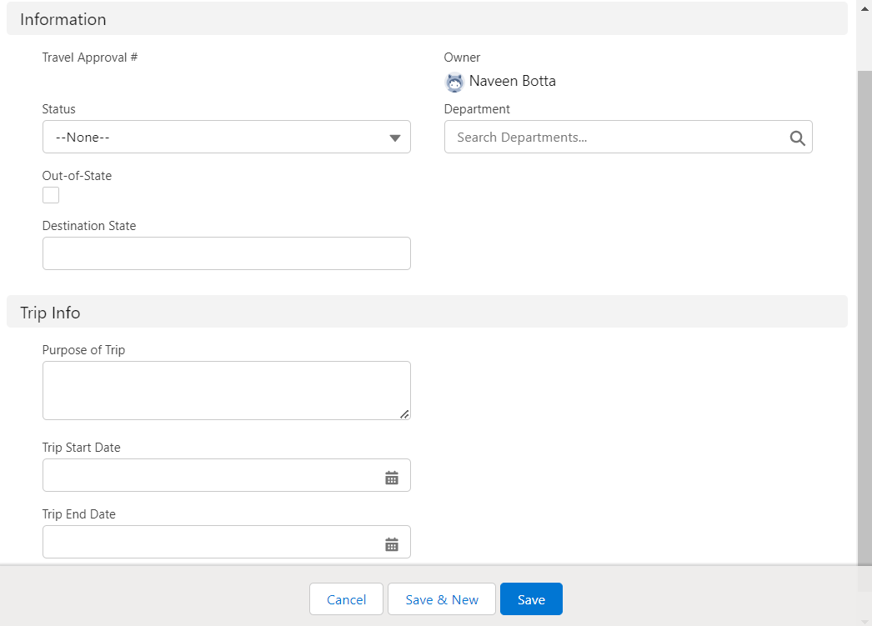
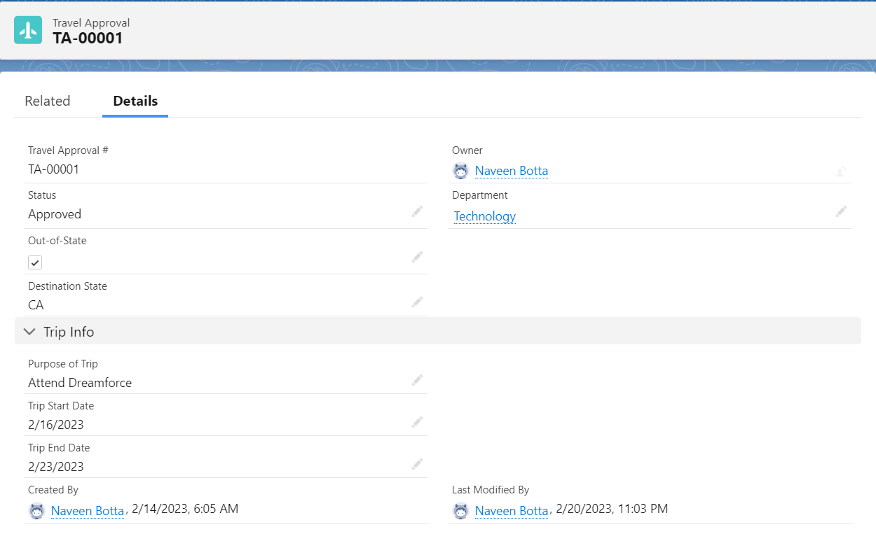
Travel Approval sObject with fields
Notes:
Key Messages
Designed to be Application Agnostic allowing multiple data systems to be mapped to it. Map individual systems to the CIM
Subject Areas for the data model are related to an individual. The party – Account & Contact, Payment, Method, Products, Sales Order and Shipment
The CIM covers the subjects
Open Source – Owned by the Linux Foundation – The model is not controlled by just one company

Slide 14
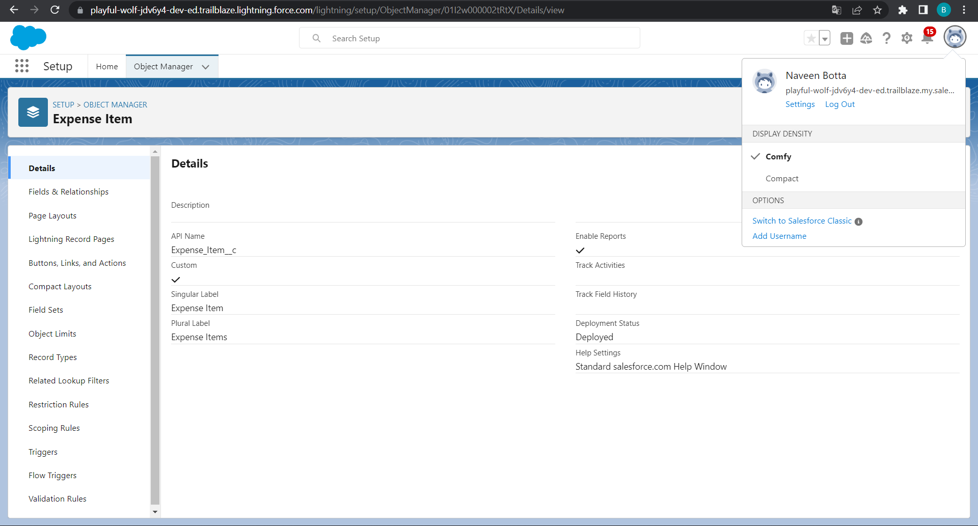
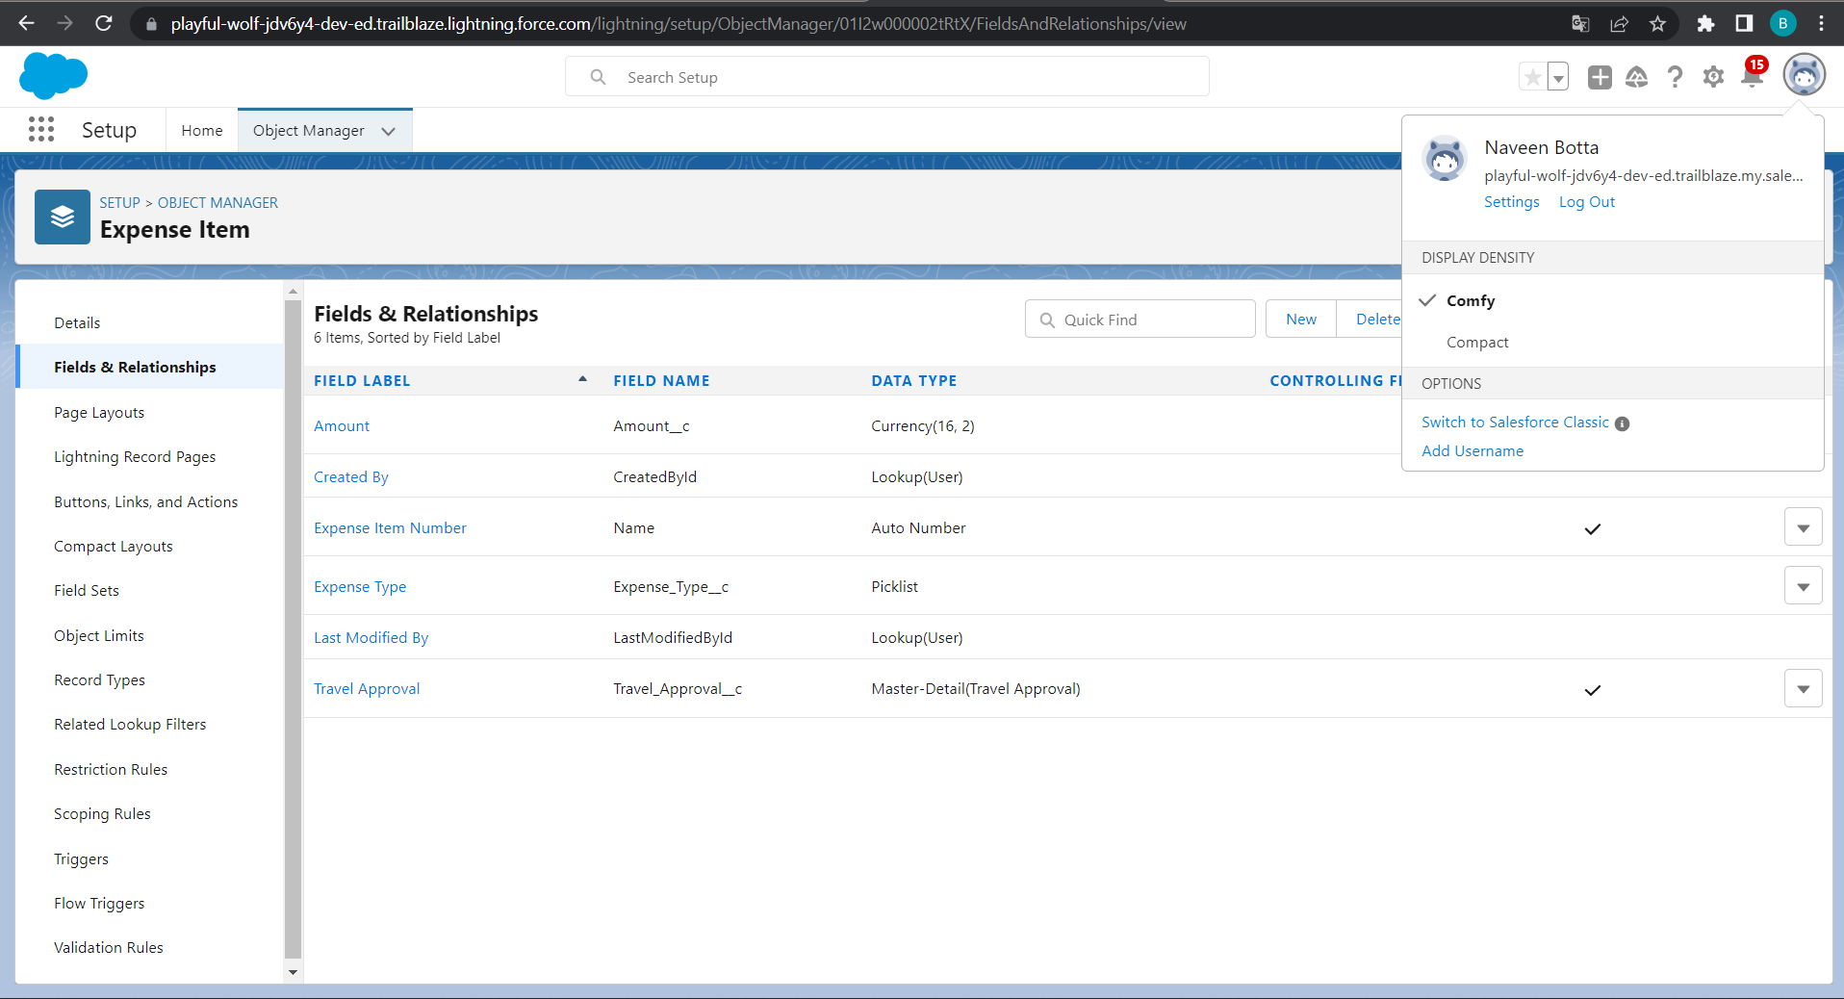
Expense Custom Object with fields and this object have master-detail relation with Travel Approval #
Notes:
Key Messages
- Helps our customers deliver a unified customer experience by making our products for B2C Service and Commerce and multiple Service Cloud orgs work together more seamlessly.
- Gives Admins a central place and a click based UI to build connectivity across the apps in a trusted and secure environment
- Builds an ID that is the foundation of connected experiences
- Powers cross-channel experiences that are delivered in pre-built packages in Service and Commerce
- Custom experiences can be built to connect multiple orgs. in Lightning Platform around individual contacts or person accounts
Talk Track
Customer 360 Data Manager gives you one place to centrally establish trusted, secure connectivity across your Salesforce applications. We’re doing away with point to point connectivity and giving you a central hub with a click based UI to manage how apps connect and the data management tools necessary to power connected experience. In the Customer 360 Data Manager you’ll find a robust set of functionality that takes data from the connected systems and creates a single ID for individuals and an accurate, up to date Contact Profile. With point and click ease, Admins will enable new, cross-channel experiences like surfacing data right from Commerce Cloud B2C into an Agent Console in Service Cloud.

Slide 15
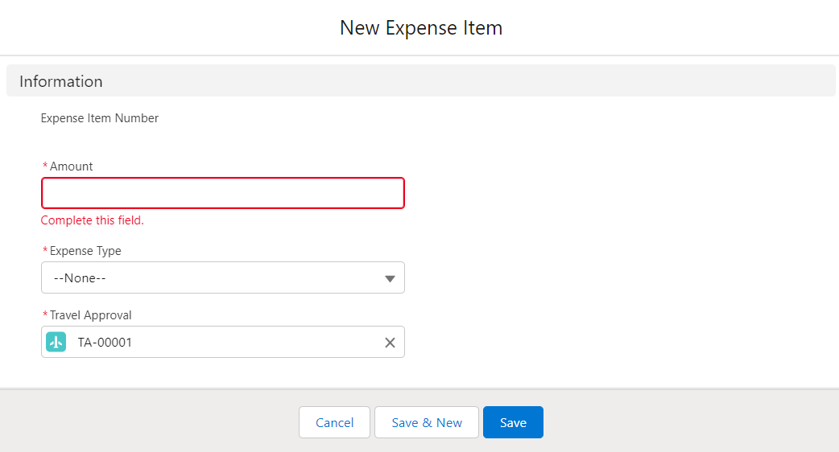
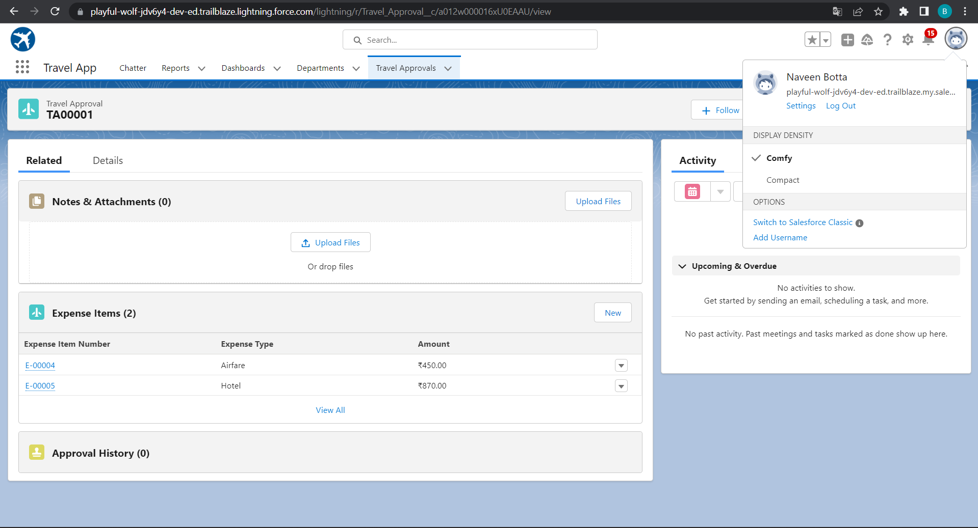
Expense related to Travel Approval #
Notes:
Key Messages
Designed to be Application Agnostic allowing multiple data systems to be mapped to it. Map individual systems to the CIM
Subject Areas for the data model are related to an individual. The party – Account & Contact, Payment, Method, Products, Sales Order and Shipment
The CIM covers the subjects
Open Source – Owned by the Linux Foundation – The model is not controlled by just one company

Slide 16
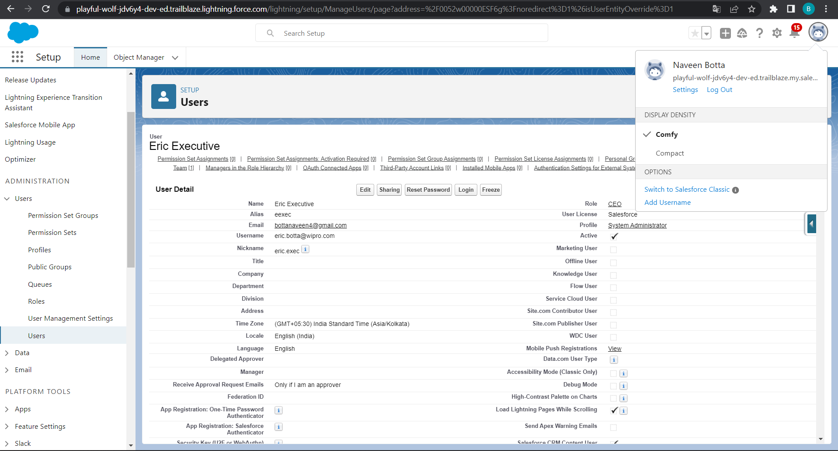
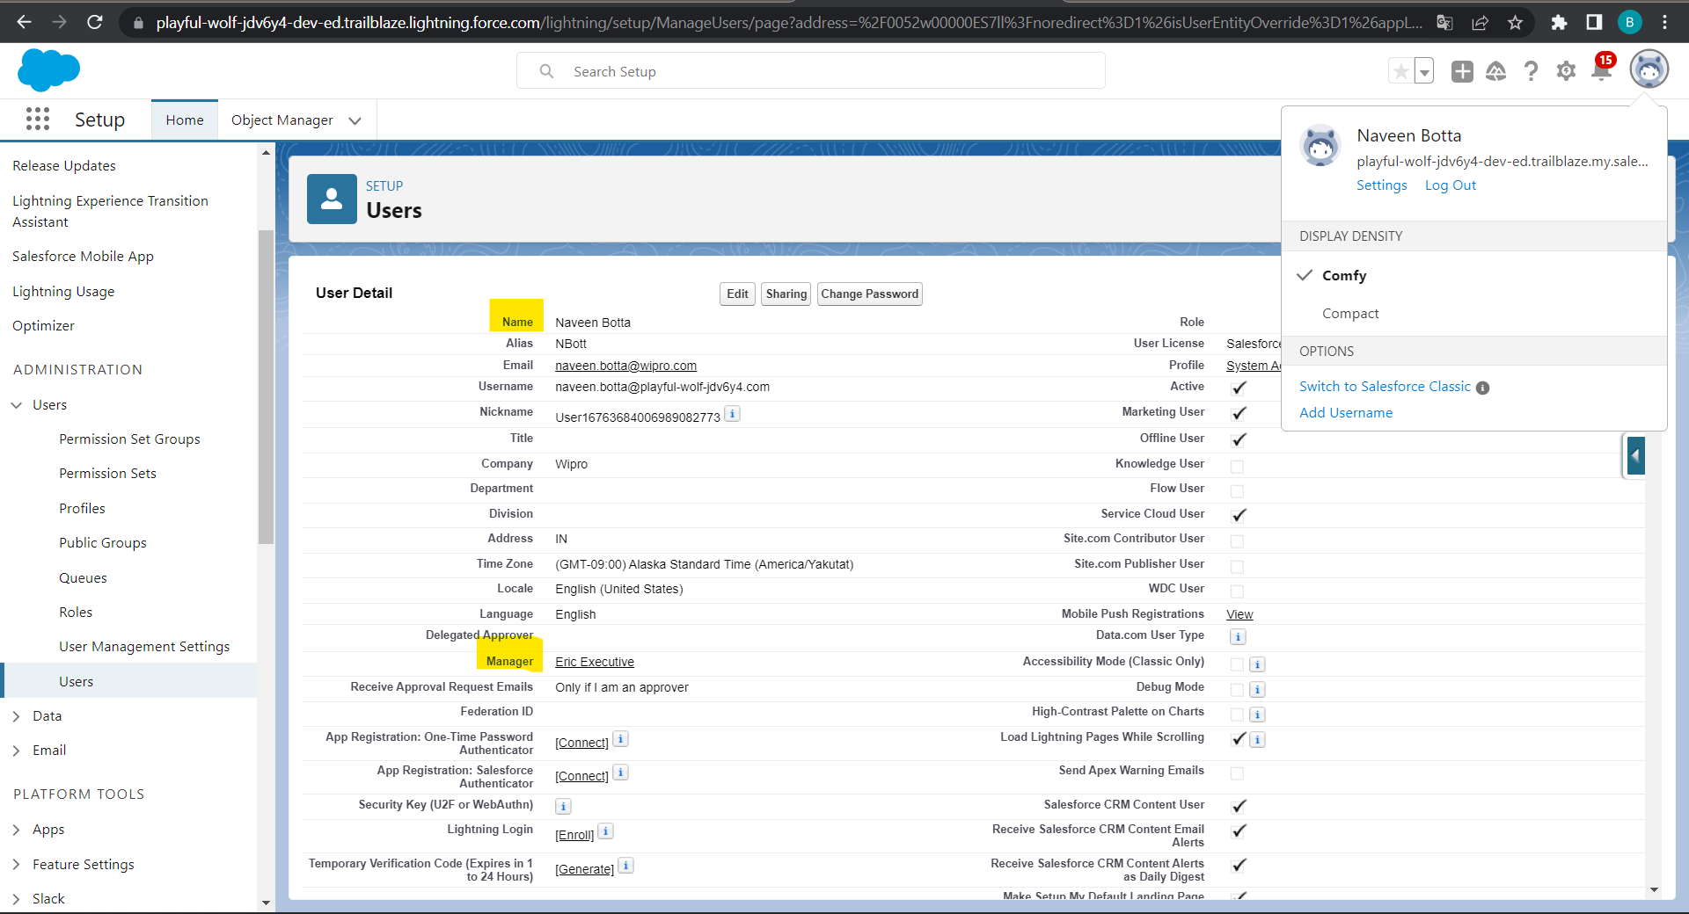
Adding Eric as system administer license and assign eric as manager own account user
Notes:
Key Messages
Designed to be Application Agnostic allowing multiple data systems to be mapped to it. Map individual systems to the CIM
Subject Areas for the data model are related to an individual. The party – Account & Contact, Payment, Method, Products, Sales Order and Shipment
The CIM covers the subjects
Open Source – Owned by the Linux Foundation – The model is not controlled by just one company

Slide 17
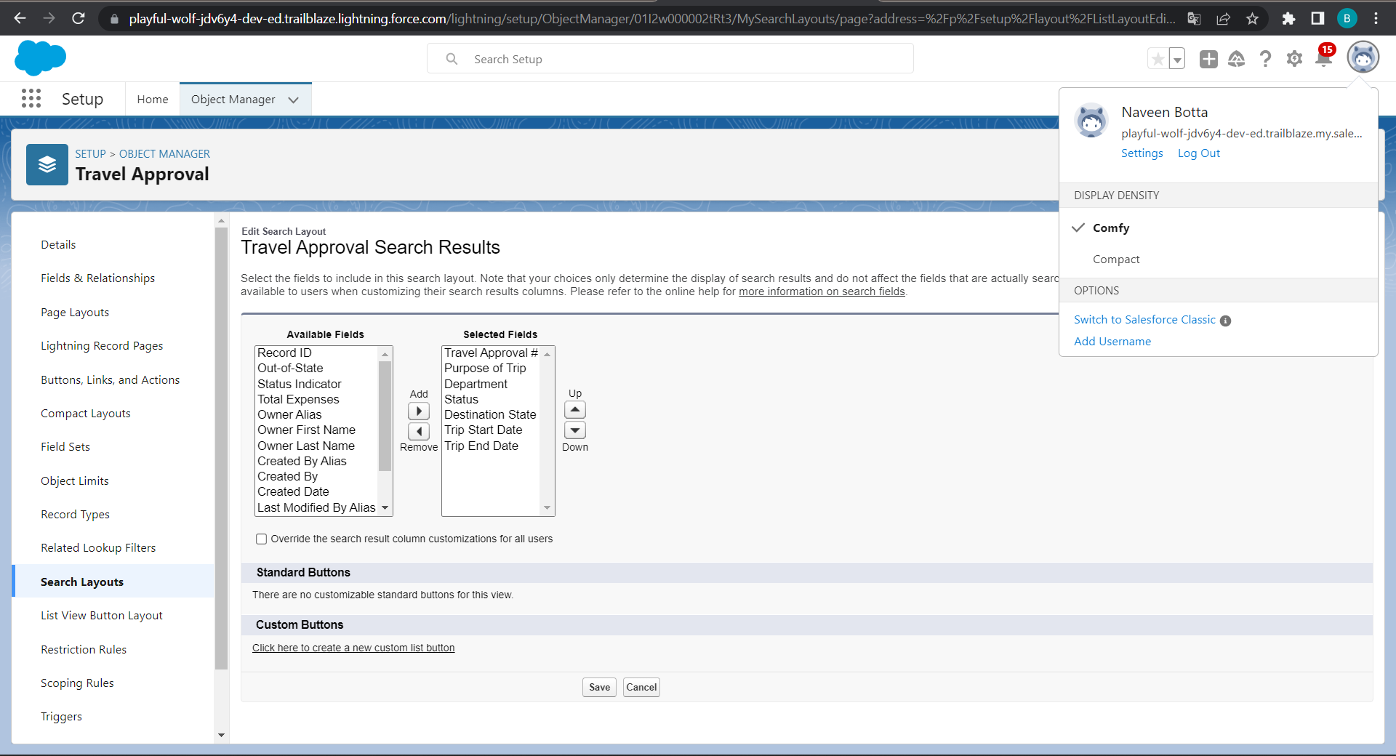
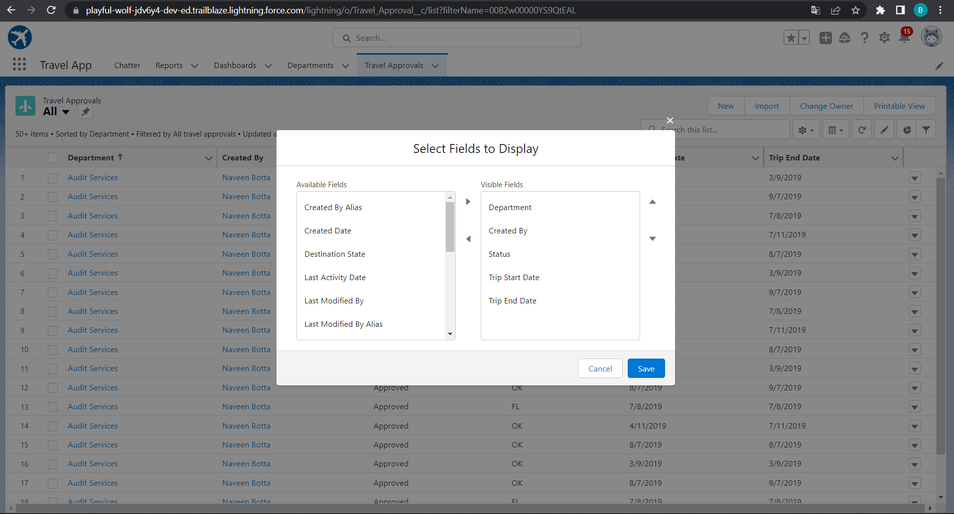
Select fields to display in the Travel Approval “All” List view
Customize the Travel Approval Default search layout
Notes:
Key Messages
- Helps our customers deliver a unified customer experience by making our products for B2C Service and Commerce and multiple Service Cloud orgs work together more seamlessly.
- Gives Admins a central place and a click based UI to build connectivity across the apps in a trusted and secure environment
- Builds an ID that is the foundation of connected experiences
- Powers cross-channel experiences that are delivered in pre-built packages in Service and Commerce
- Custom experiences can be built to connect multiple orgs. in Lightning Platform around individual contacts or person accounts
Talk Track
Customer 360 Data Manager gives you one place to centrally establish trusted, secure connectivity across your Salesforce applications. We’re doing away with point to point connectivity and giving you a central hub with a click based UI to manage how apps connect and the data management tools necessary to power connected experience. In the Customer 360 Data Manager you’ll find a robust set of functionality that takes data from the connected systems and creates a single ID for individuals and an accurate, up to date Contact Profile. With point and click ease, Admins will enable new, cross-channel experiences like surfacing data right from Commerce Cloud B2C into an Agent Console in Service Cloud.

Slide 18
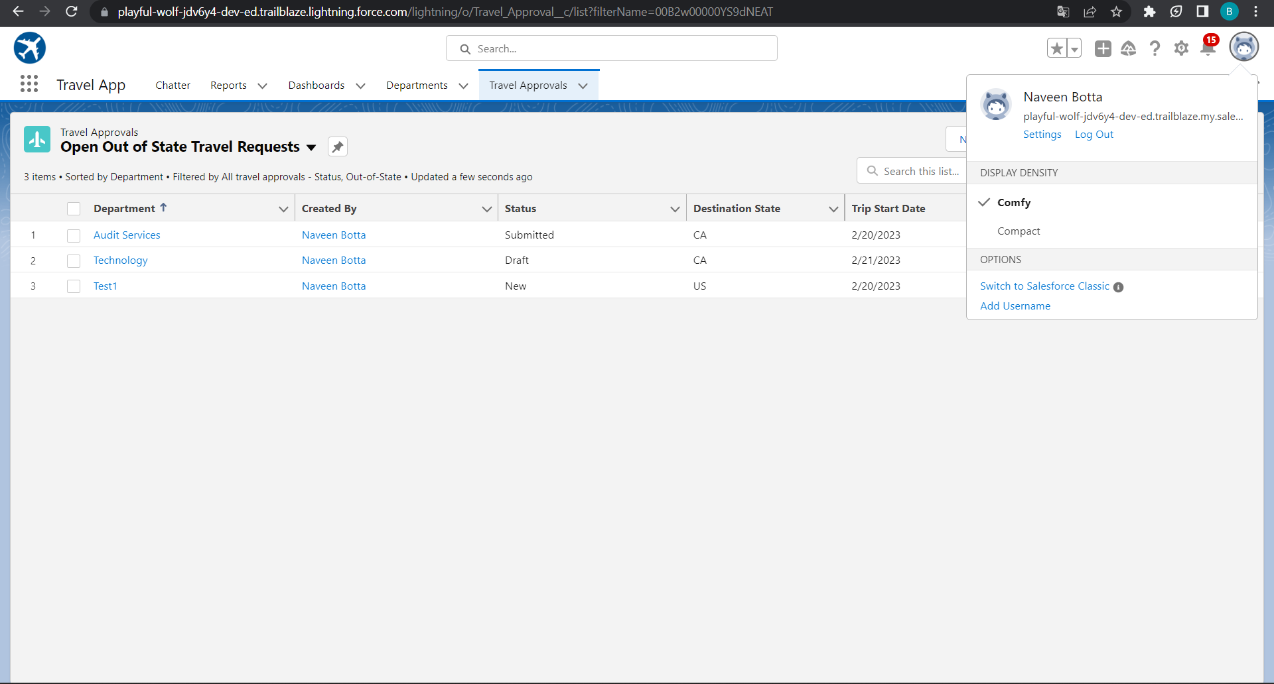
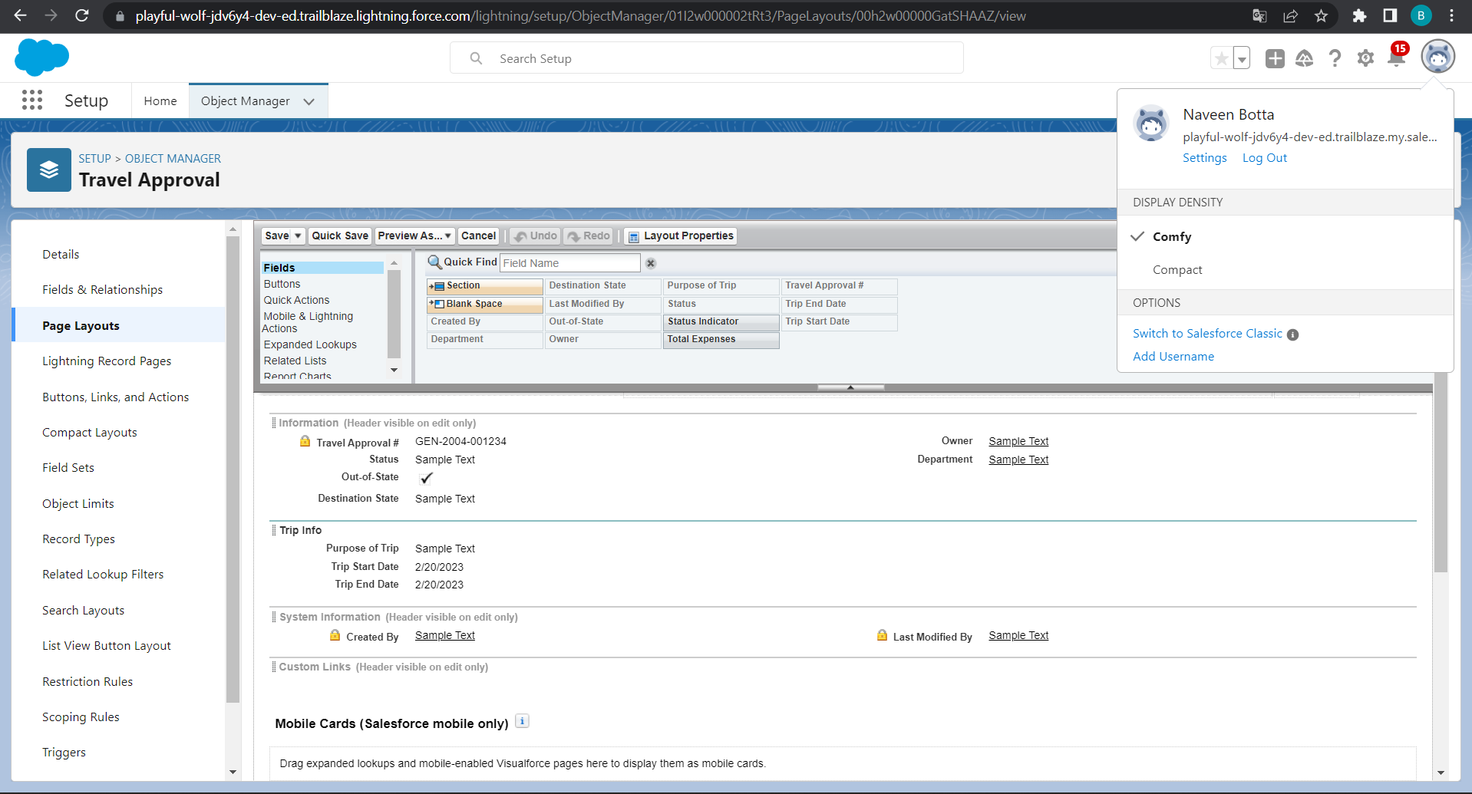
Open Out of state Travel Request
Page Layout for travel approval
Notes:
Key Messages
- Helps our customers deliver a unified customer experience by making our products for B2C Service and Commerce and multiple Service Cloud orgs work together more seamlessly.
- Gives Admins a central place and a click based UI to build connectivity across the apps in a trusted and secure environment
- Builds an ID that is the foundation of connected experiences
- Powers cross-channel experiences that are delivered in pre-built packages in Service and Commerce
- Custom experiences can be built to connect multiple orgs. in Lightning Platform around individual contacts or person accounts
Talk Track
Customer 360 Data Manager gives you one place to centrally establish trusted, secure connectivity across your Salesforce applications. We’re doing away with point to point connectivity and giving you a central hub with a click based UI to manage how apps connect and the data management tools necessary to power connected experience. In the Customer 360 Data Manager you’ll find a robust set of functionality that takes data from the connected systems and creates a single ID for individuals and an accurate, up to date Contact Profile. With point and click ease, Admins will enable new, cross-channel experiences like surfacing data right from Commerce Cloud B2C into an Agent Console in Service Cloud.

Slide 19
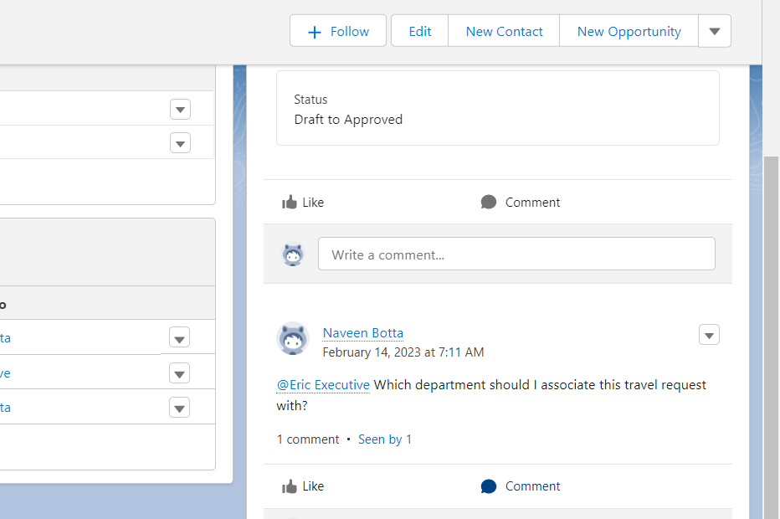
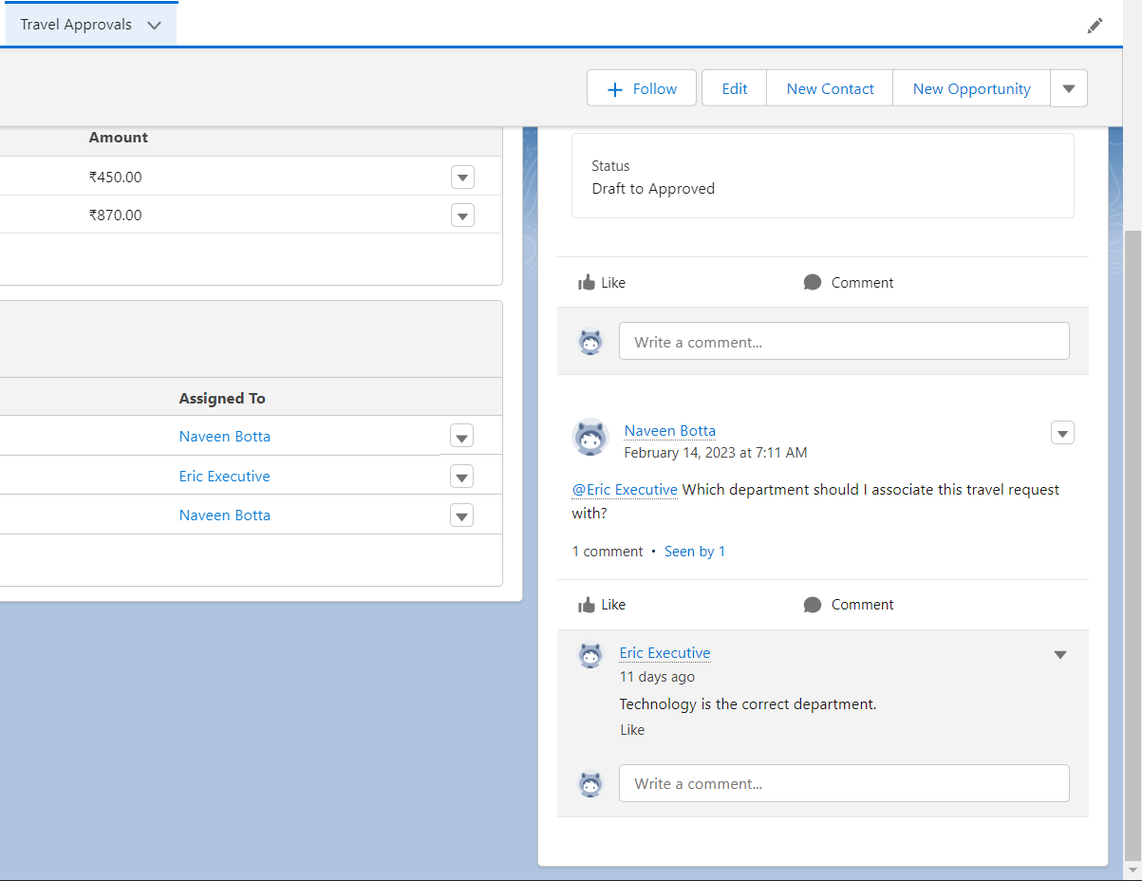
Testing Chatter
Send message in chatter
Commenting on message
Notes:
Key Messages
Designed to be Application Agnostic allowing multiple data systems to be mapped to it. Map individual systems to the CIM
Subject Areas for the data model are related to an individual. The party – Account & Contact, Payment, Method, Products, Sales Order and Shipment
The CIM covers the subjects
Open Source – Owned by the Linux Foundation – The model is not controlled by just one company

Slide 20
Module 2
Create, Setup, Configure, Test
This module will test Salesforce skills based on how to define Business logic using Validation rules, Roll-up summary fields, Formulas, Flows & how to track Travel Approvals using Reports and Dashboards.
Notes:
Use Cases:
The only way to integrate multiple Core orgs together
B2C Commerce: Customer Profile, Order
Service Cloud, Sales Cloud, Platform: Account (e.g. Person Account), Contact, Lead, Individual
Languages: Danish, Dutch, English, Finnish, French, German, Italian, Norwegian, Portuguese, Spanish, Swedish

Slide 21
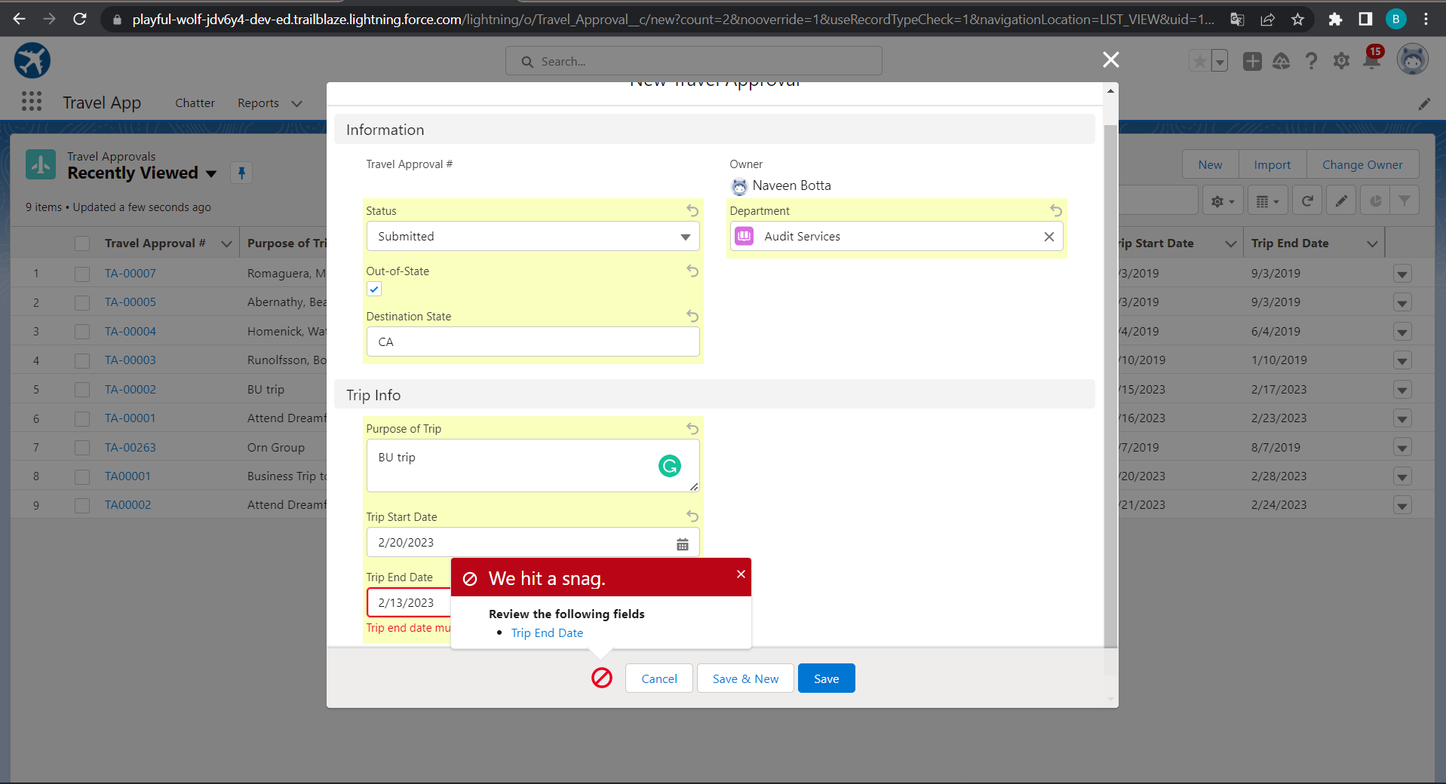
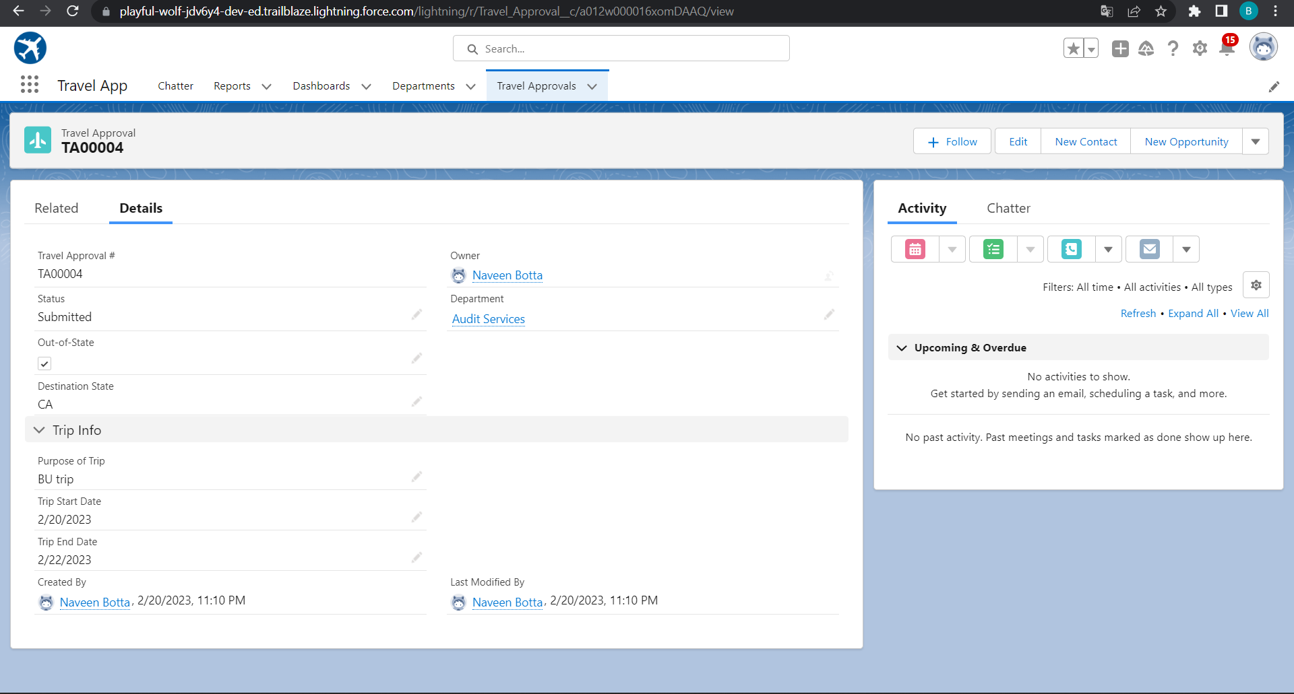
Validation Rule that trip end date always >= start date
Notes:
Key Messages
Designed to be Application Agnostic allowing multiple data systems to be mapped to it. Map individual systems to the CIM
Subject Areas for the data model are related to an individual. The party – Account & Contact, Payment, Method, Products, Sales Order and Shipment
The CIM covers the subjects
Open Source – Owned by the Linux Foundation – The model is not controlled by just one company

Slide 22
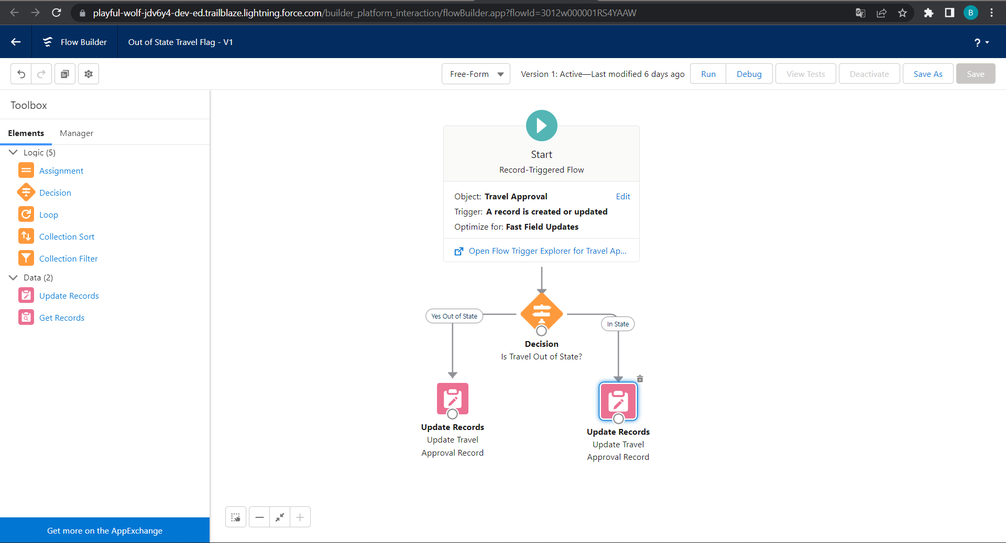
Flow for to check out of state or in state
Notes:
Key Messages
- Helps our customers deliver a unified customer experience by making our products for B2C Service and Commerce and multiple Service Cloud orgs work together more seamlessly.
- Gives Admins a central place and a click based UI to build connectivity across the apps in a trusted and secure environment
- Builds an ID that is the foundation of connected experiences
- Powers cross-channel experiences that are delivered in pre-built packages in Service and Commerce
- Custom experiences can be built to connect multiple orgs. in Lightning Platform around individual contacts or person accounts
Talk Track
Customer 360 Data Manager gives you one place to centrally establish trusted, secure connectivity across your Salesforce applications. We’re doing away with point to point connectivity and giving you a central hub with a click based UI to manage how apps connect and the data management tools necessary to power connected experience. In the Customer 360 Data Manager you’ll find a robust set of functionality that takes data from the connected systems and creates a single ID for individuals and an accurate, up to date Contact Profile. With point and click ease, Admins will enable new, cross-channel experiences like surfacing data right from Commerce Cloud B2C into an Agent Console in Service Cloud.

Slide 23
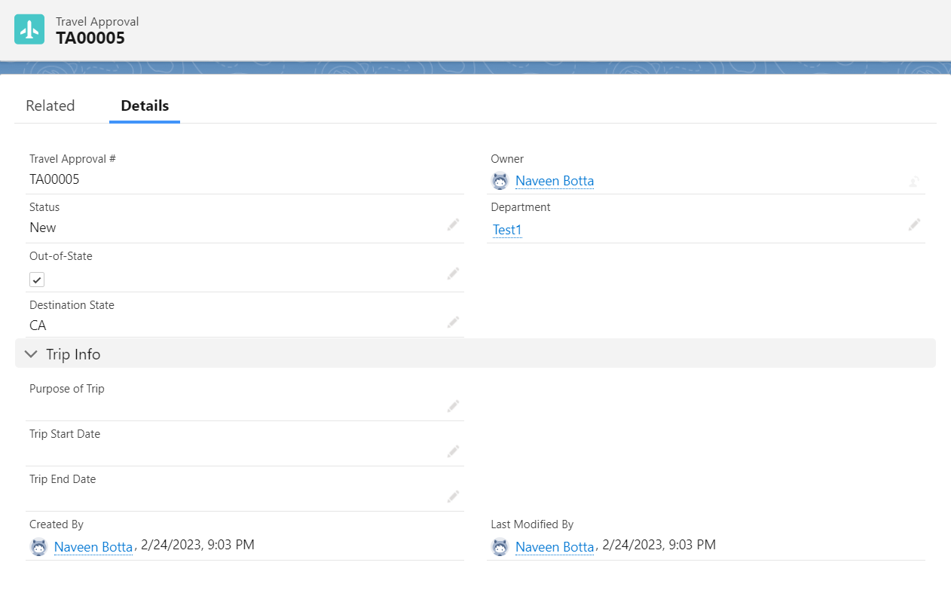
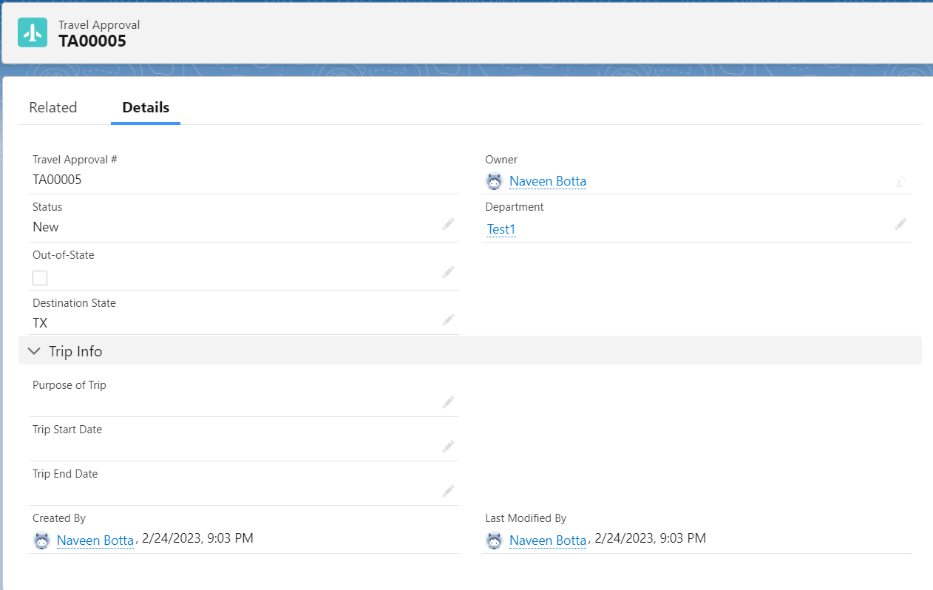
Notes:
Key Messages
- Helps our customers deliver a unified customer experience by making our products for B2C Service and Commerce and multiple Service Cloud orgs work together more seamlessly.
- Gives Admins a central place and a click based UI to build connectivity across the apps in a trusted and secure environment
- Builds an ID that is the foundation of connected experiences
- Powers cross-channel experiences that are delivered in pre-built packages in Service and Commerce
- Custom experiences can be built to connect multiple orgs. in Lightning Platform around individual contacts or person accounts
Talk Track
Customer 360 Data Manager gives you one place to centrally establish trusted, secure connectivity across your Salesforce applications. We’re doing away with point to point connectivity and giving you a central hub with a click based UI to manage how apps connect and the data management tools necessary to power connected experience. In the Customer 360 Data Manager you’ll find a robust set of functionality that takes data from the connected systems and creates a single ID for individuals and an accurate, up to date Contact Profile. With point and click ease, Admins will enable new, cross-channel experiences like surfacing data right from Commerce Cloud B2C into an Agent Console in Service Cloud.

Slide 24
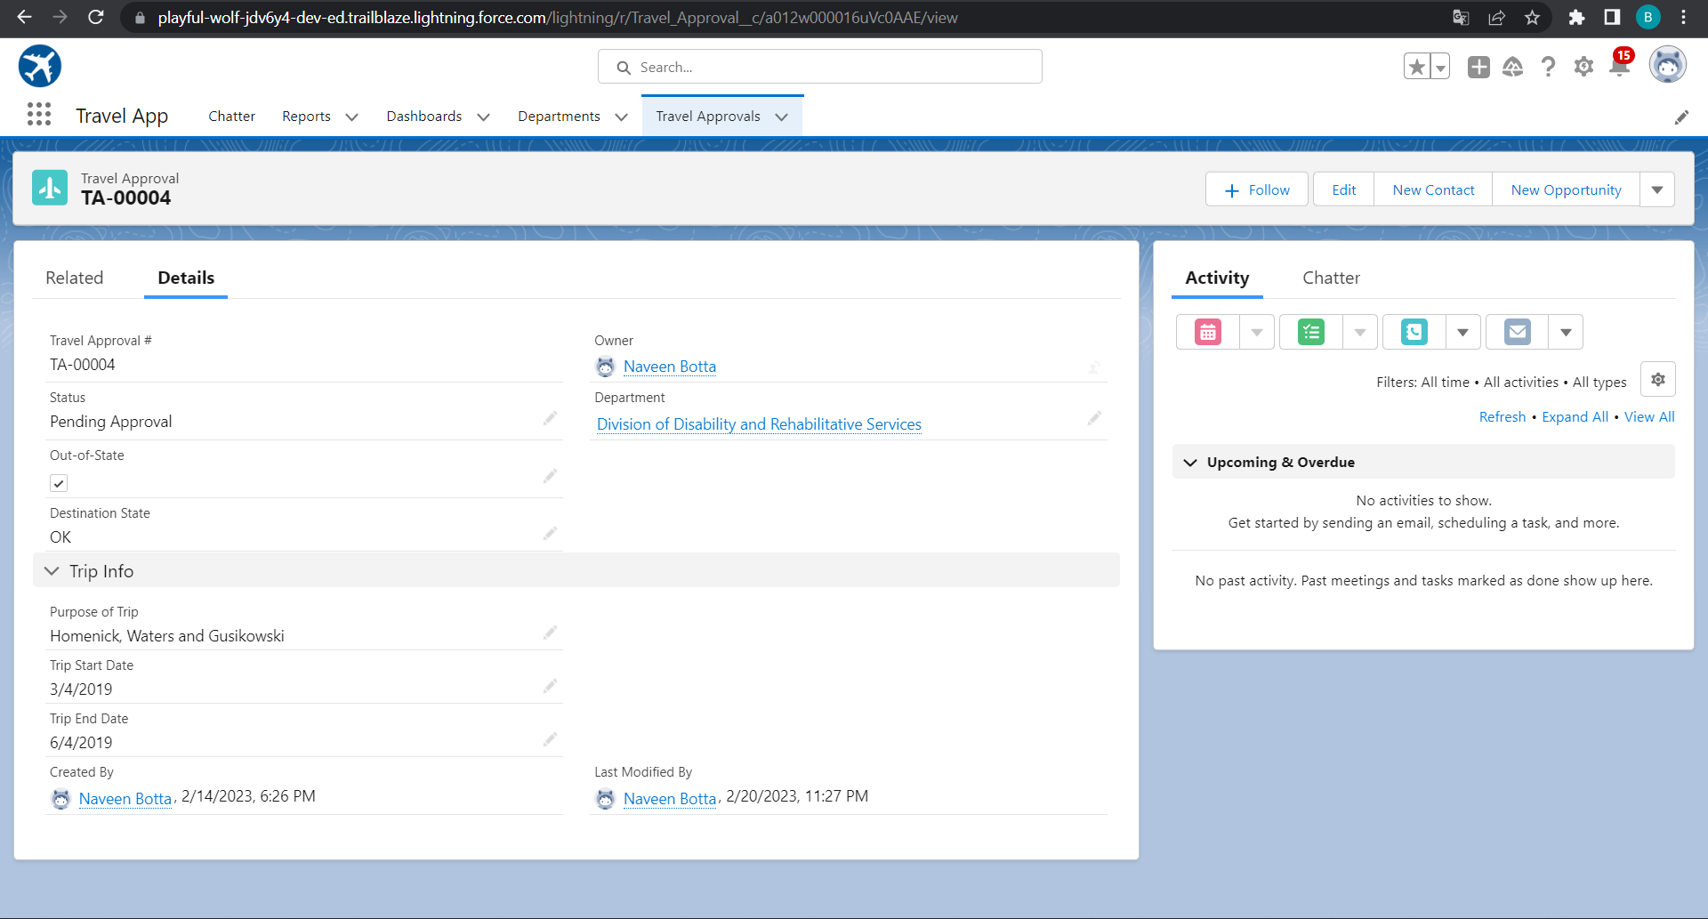
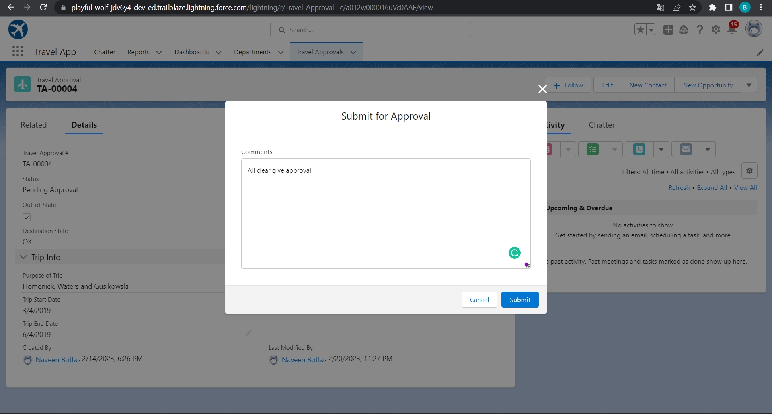
Approval Process To Send Travel Approvals To Manager Or Travel Coordinator
Notes:
Key Messages
Designed to be Application Agnostic allowing multiple data systems to be mapped to it. Map individual systems to the CIM
Subject Areas for the data model are related to an individual. The party – Account & Contact, Payment, Method, Products, Sales Order and Shipment
The CIM covers the subjects
Open Source – Owned by the Linux Foundation – The model is not controlled by just one company

Slide 25
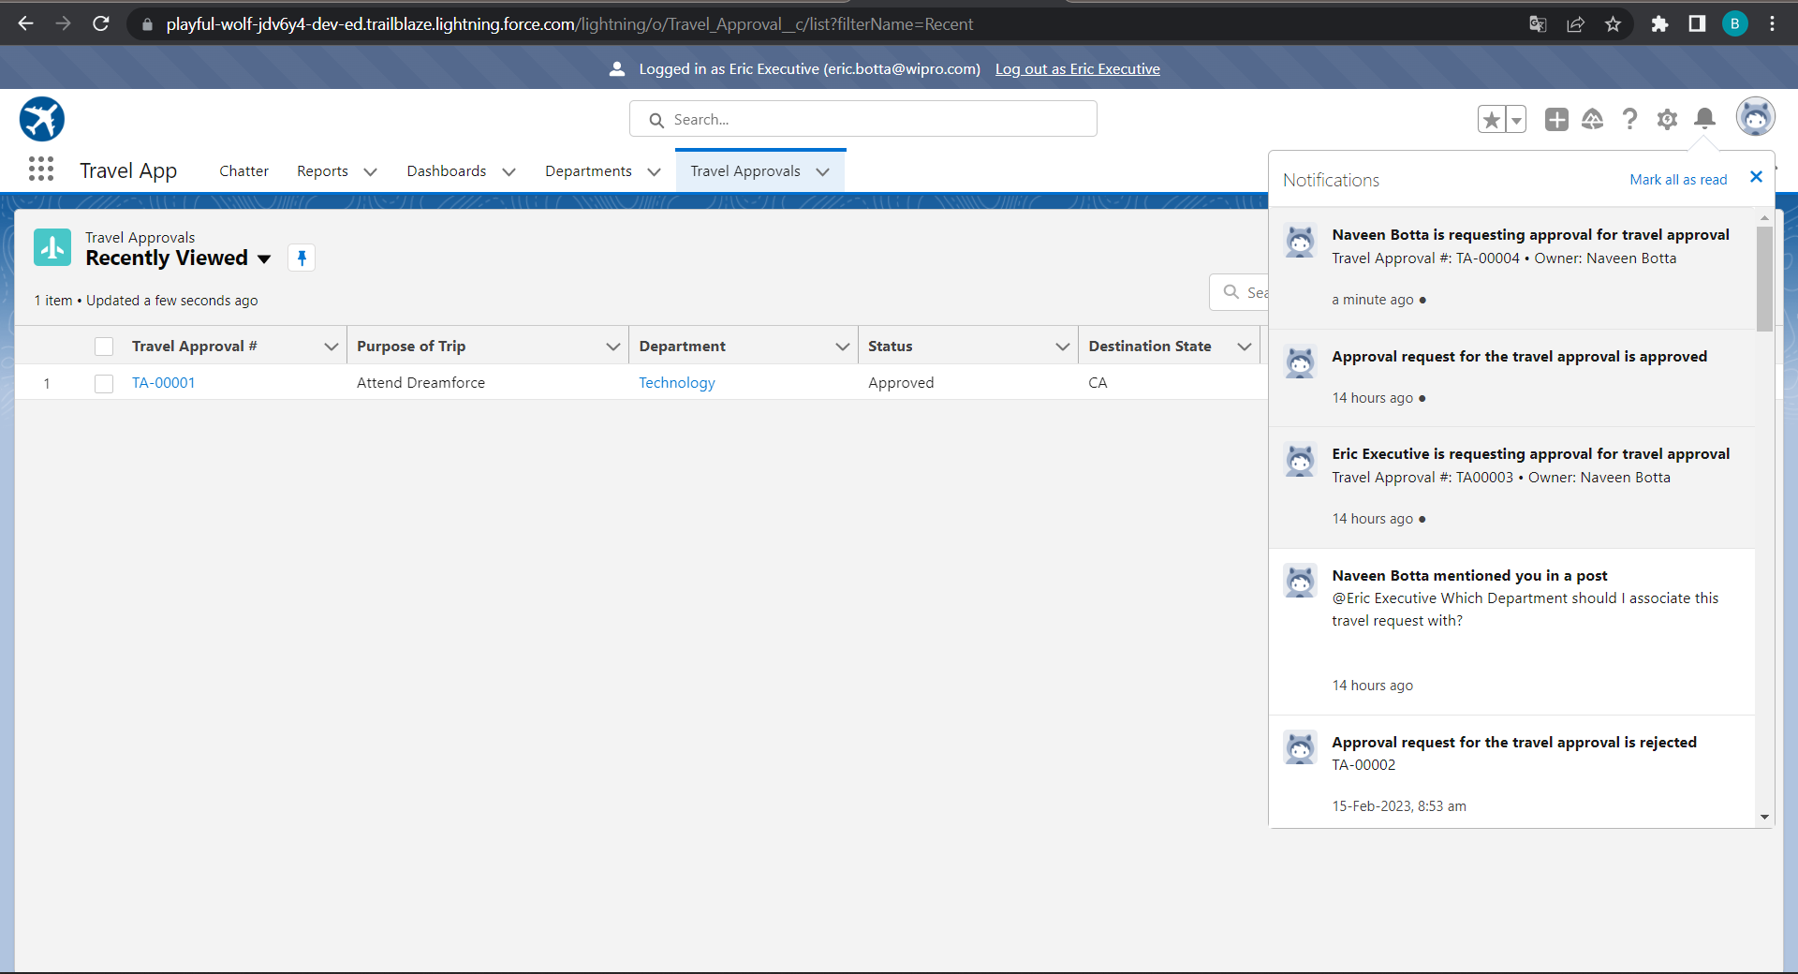
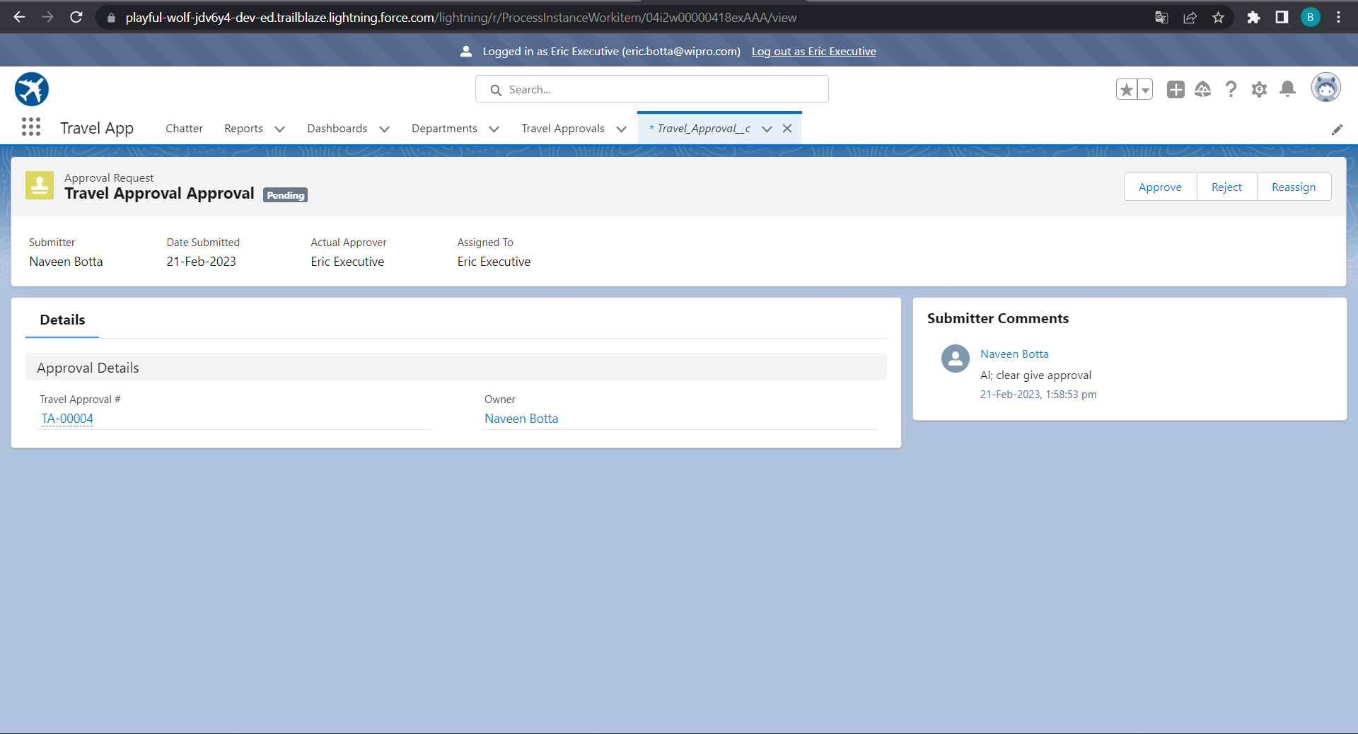
Login As Eric And Give Approval Or Reject It
Notes:
Key Messages
Designed to be Application Agnostic allowing multiple data systems to be mapped to it. Map individual systems to the CIM
Subject Areas for the data model are related to an individual. The party – Account & Contact, Payment, Method, Products, Sales Order and Shipment
The CIM covers the subjects
Open Source – Owned by the Linux Foundation – The model is not controlled by just one company

Slide 26
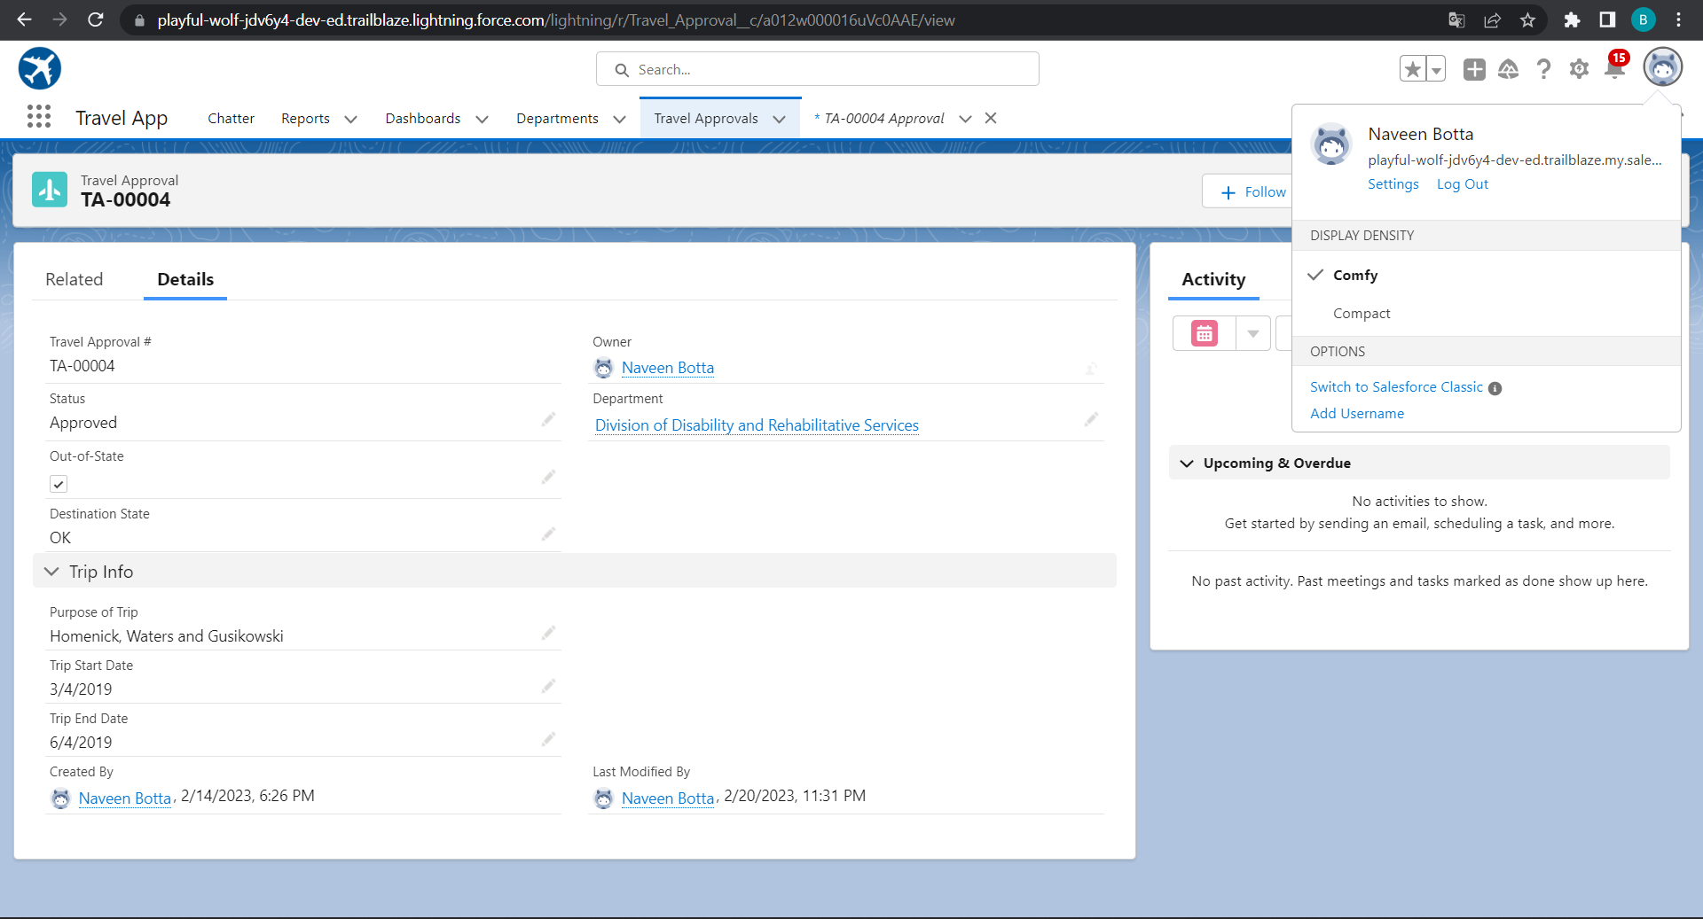
After Getting Approval From Eric
Notes:
Key Messages
Designed to be Application Agnostic allowing multiple data systems to be mapped to it. Map individual systems to the CIM
Subject Areas for the data model are related to an individual. The party – Account & Contact, Payment, Method, Products, Sales Order and Shipment
The CIM covers the subjects
Open Source – Owned by the Linux Foundation – The model is not controlled by just one company

Slide 27
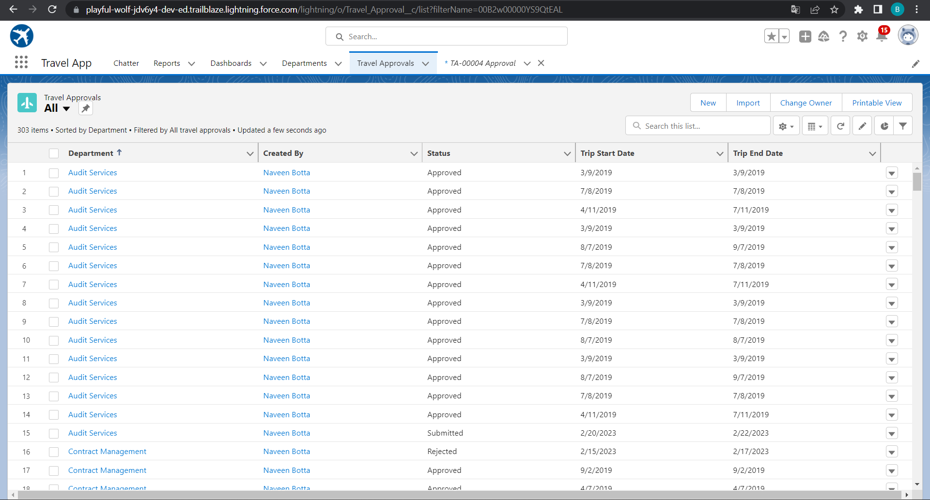
Using Data Import Wizard To Import Travel Approval Records , Later The Records Imported Successfully
Notes:
Key Messages
- Helps our customers deliver a unified customer experience by making our products for B2C Service and Commerce and multiple Service Cloud orgs work together more seamlessly.
- Gives Admins a central place and a click based UI to build connectivity across the apps in a trusted and secure environment
- Builds an ID that is the foundation of connected experiences
- Powers cross-channel experiences that are delivered in pre-built packages in Service and Commerce
- Custom experiences can be built to connect multiple orgs. in Lightning Platform around individual contacts or person accounts
Talk Track
Customer 360 Data Manager gives you one place to centrally establish trusted, secure connectivity across your Salesforce applications. We’re doing away with point to point connectivity and giving you a central hub with a click based UI to manage how apps connect and the data management tools necessary to power connected experience. In the Customer 360 Data Manager you’ll find a robust set of functionality that takes data from the connected systems and creates a single ID for individuals and an accurate, up to date Contact Profile. With point and click ease, Admins will enable new, cross-channel experiences like surfacing data right from Commerce Cloud B2C into an Agent Console in Service Cloud.

Slide 28
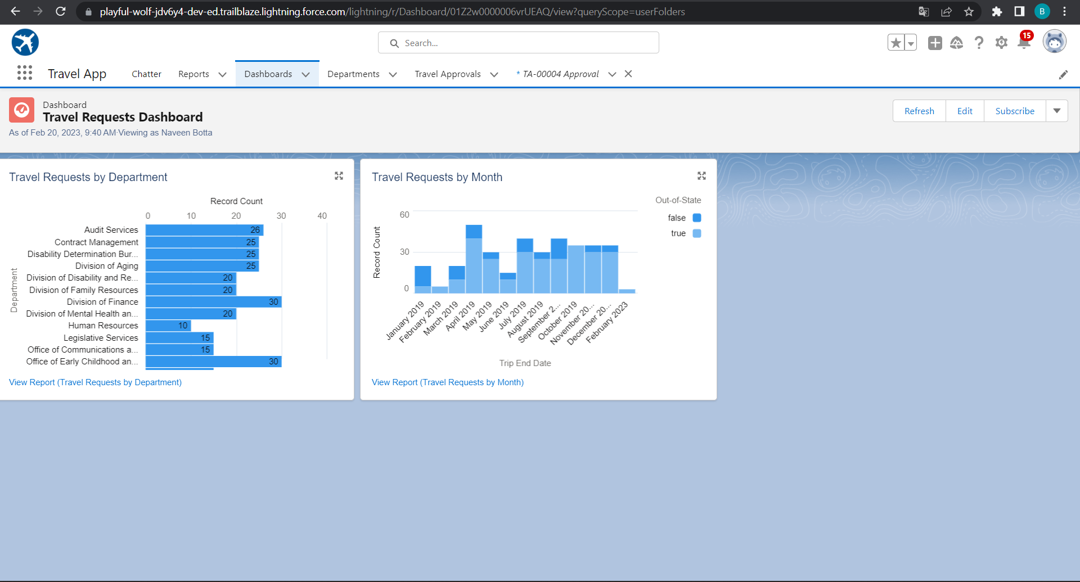
Dashboard For Travel Request By Department And Travel Request By Month
Notes:
Key Messages
- Helps our customers deliver a unified customer experience by making our products for B2C Service and Commerce and multiple Service Cloud orgs work together more seamlessly.
- Gives Admins a central place and a click based UI to build connectivity across the apps in a trusted and secure environment
- Builds an ID that is the foundation of connected experiences
- Powers cross-channel experiences that are delivered in pre-built packages in Service and Commerce
- Custom experiences can be built to connect multiple orgs. in Lightning Platform around individual contacts or person accounts
Talk Track
Customer 360 Data Manager gives you one place to centrally establish trusted, secure connectivity across your Salesforce applications. We’re doing away with point to point connectivity and giving you a central hub with a click based UI to manage how apps connect and the data management tools necessary to power connected experience. In the Customer 360 Data Manager you’ll find a robust set of functionality that takes data from the connected systems and creates a single ID for individuals and an accurate, up to date Contact Profile. With point and click ease, Admins will enable new, cross-channel experiences like surfacing data right from Commerce Cloud B2C into an Agent Console in Service Cloud.

Slide 29
Module 3
This project module focuses on the coding approach to extend the functional capabilities of your custom App.
Notes:
Use Cases:
The only way to integrate multiple Core orgs together
B2C Commerce: Customer Profile, Order
Service Cloud, Sales Cloud, Platform: Account (e.g. Person Account), Contact, Lead, Individual
Languages: Danish, Dutch, English, Finnish, French, German, Italian, Norwegian, Portuguese, Spanish, Swedish

Slide 30
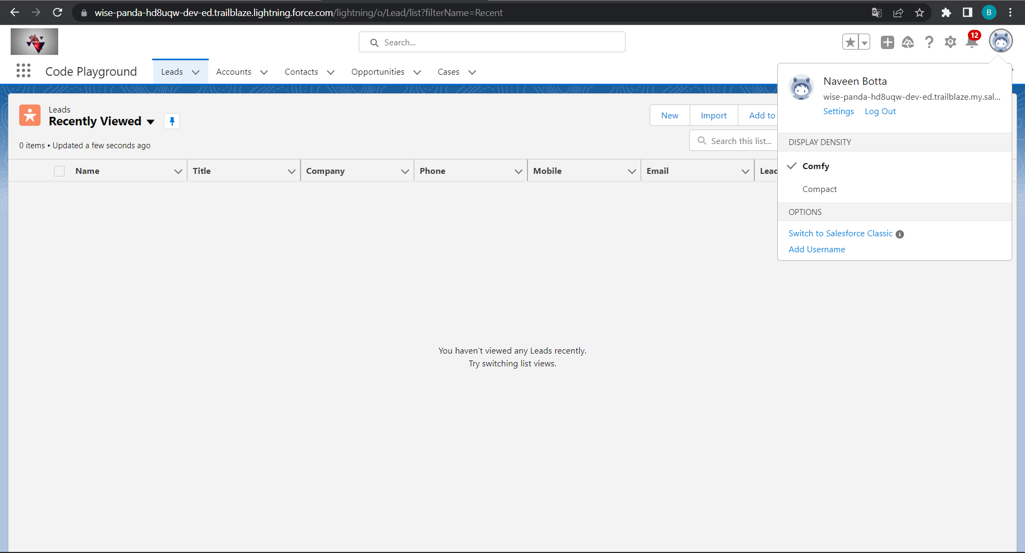
Exercise - 01 Creating Code Playground Lightning App with Lead, Account, Contact, Opportunity, Case to navigation profile as system admin.
Notes:
Key Messages
Designed to be Application Agnostic allowing multiple data systems to be mapped to it. Map individual systems to the CIM
Subject Areas for the data model are related to an individual. The party – Account & Contact, Payment, Method, Products, Sales Order and Shipment
The CIM covers the subjects
Open Source – Owned by the Linux Foundation – The model is not controlled by just one company

Slide 31
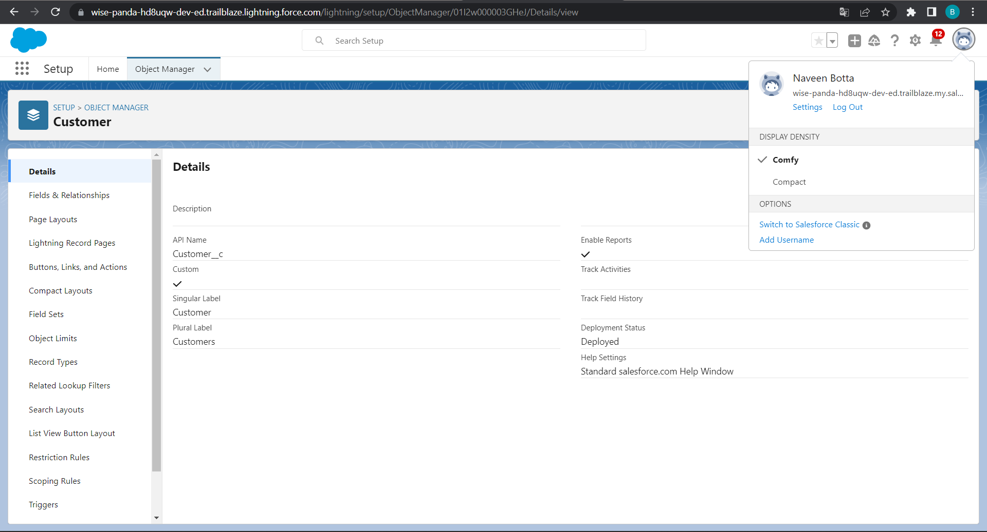
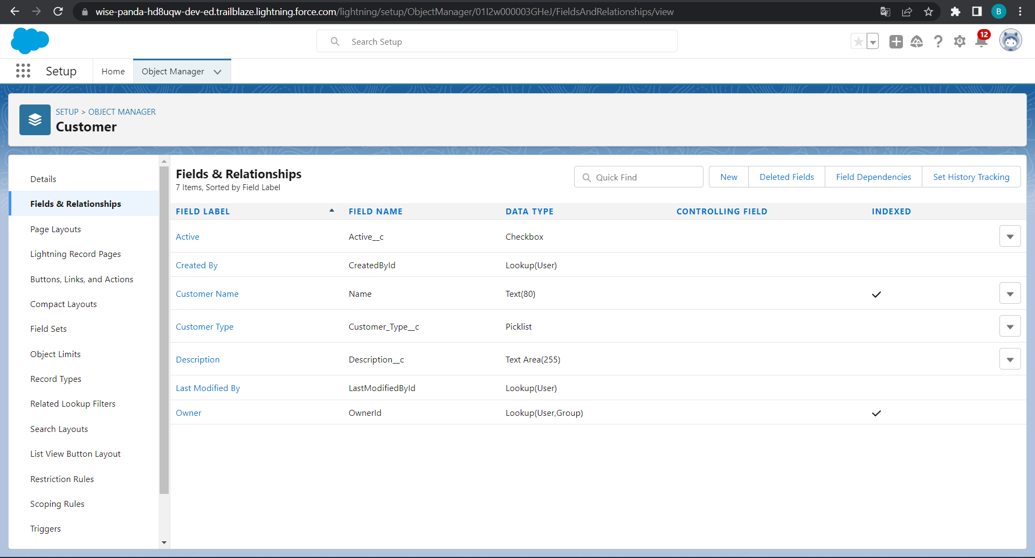
Customer Object and Fields
Notes:
Key Messages
Designed to be Application Agnostic allowing multiple data systems to be mapped to it. Map individual systems to the CIM
Subject Areas for the data model are related to an individual. The party – Account & Contact, Payment, Method, Products, Sales Order and Shipment
The CIM covers the subjects
Open Source – Owned by the Linux Foundation – The model is not controlled by just one company

Slide 32

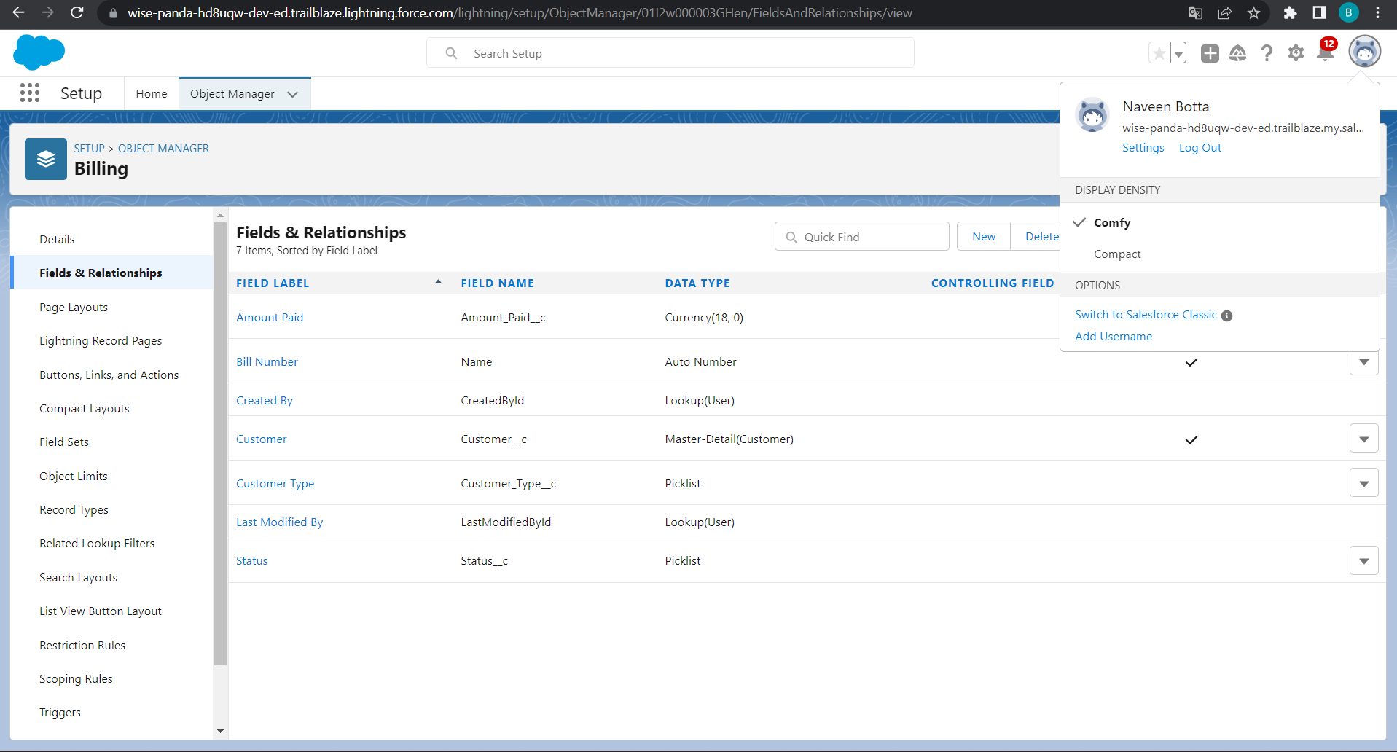
Billing object and fields
Notes:
Key Messages
Designed to be Application Agnostic allowing multiple data systems to be mapped to it. Map individual systems to the CIM
Subject Areas for the data model are related to an individual. The party – Account & Contact, Payment, Method, Products, Sales Order and Shipment
The CIM covers the subjects
Open Source – Owned by the Linux Foundation – The model is not controlled by just one company

Slide 33
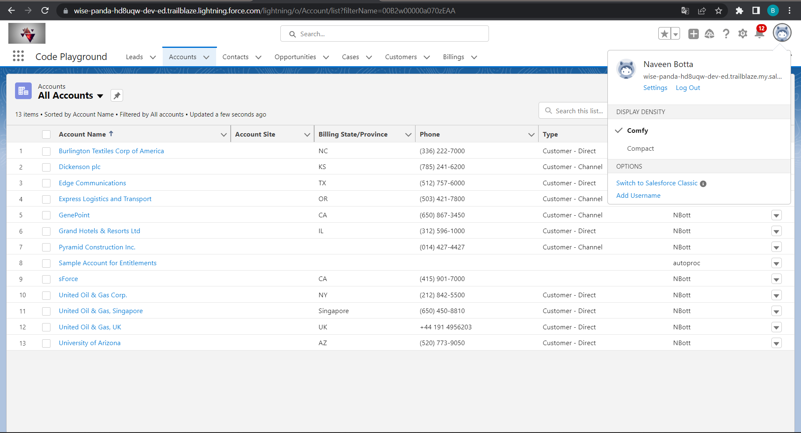
Final View
Notes:
Key Messages
- Helps our customers deliver a unified customer experience by making our products for B2C Service and Commerce and multiple Service Cloud orgs work together more seamlessly.
- Gives Admins a central place and a click based UI to build connectivity across the apps in a trusted and secure environment
- Builds an ID that is the foundation of connected experiences
- Powers cross-channel experiences that are delivered in pre-built packages in Service and Commerce
- Custom experiences can be built to connect multiple orgs. in Lightning Platform around individual contacts or person accounts
Talk Track
Customer 360 Data Manager gives you one place to centrally establish trusted, secure connectivity across your Salesforce applications. We’re doing away with point to point connectivity and giving you a central hub with a click based UI to manage how apps connect and the data management tools necessary to power connected experience. In the Customer 360 Data Manager you’ll find a robust set of functionality that takes data from the connected systems and creates a single ID for individuals and an accurate, up to date Contact Profile. With point and click ease, Admins will enable new, cross-channel experiences like surfacing data right from Commerce Cloud B2C into an Agent Console in Service Cloud.

Slide 34
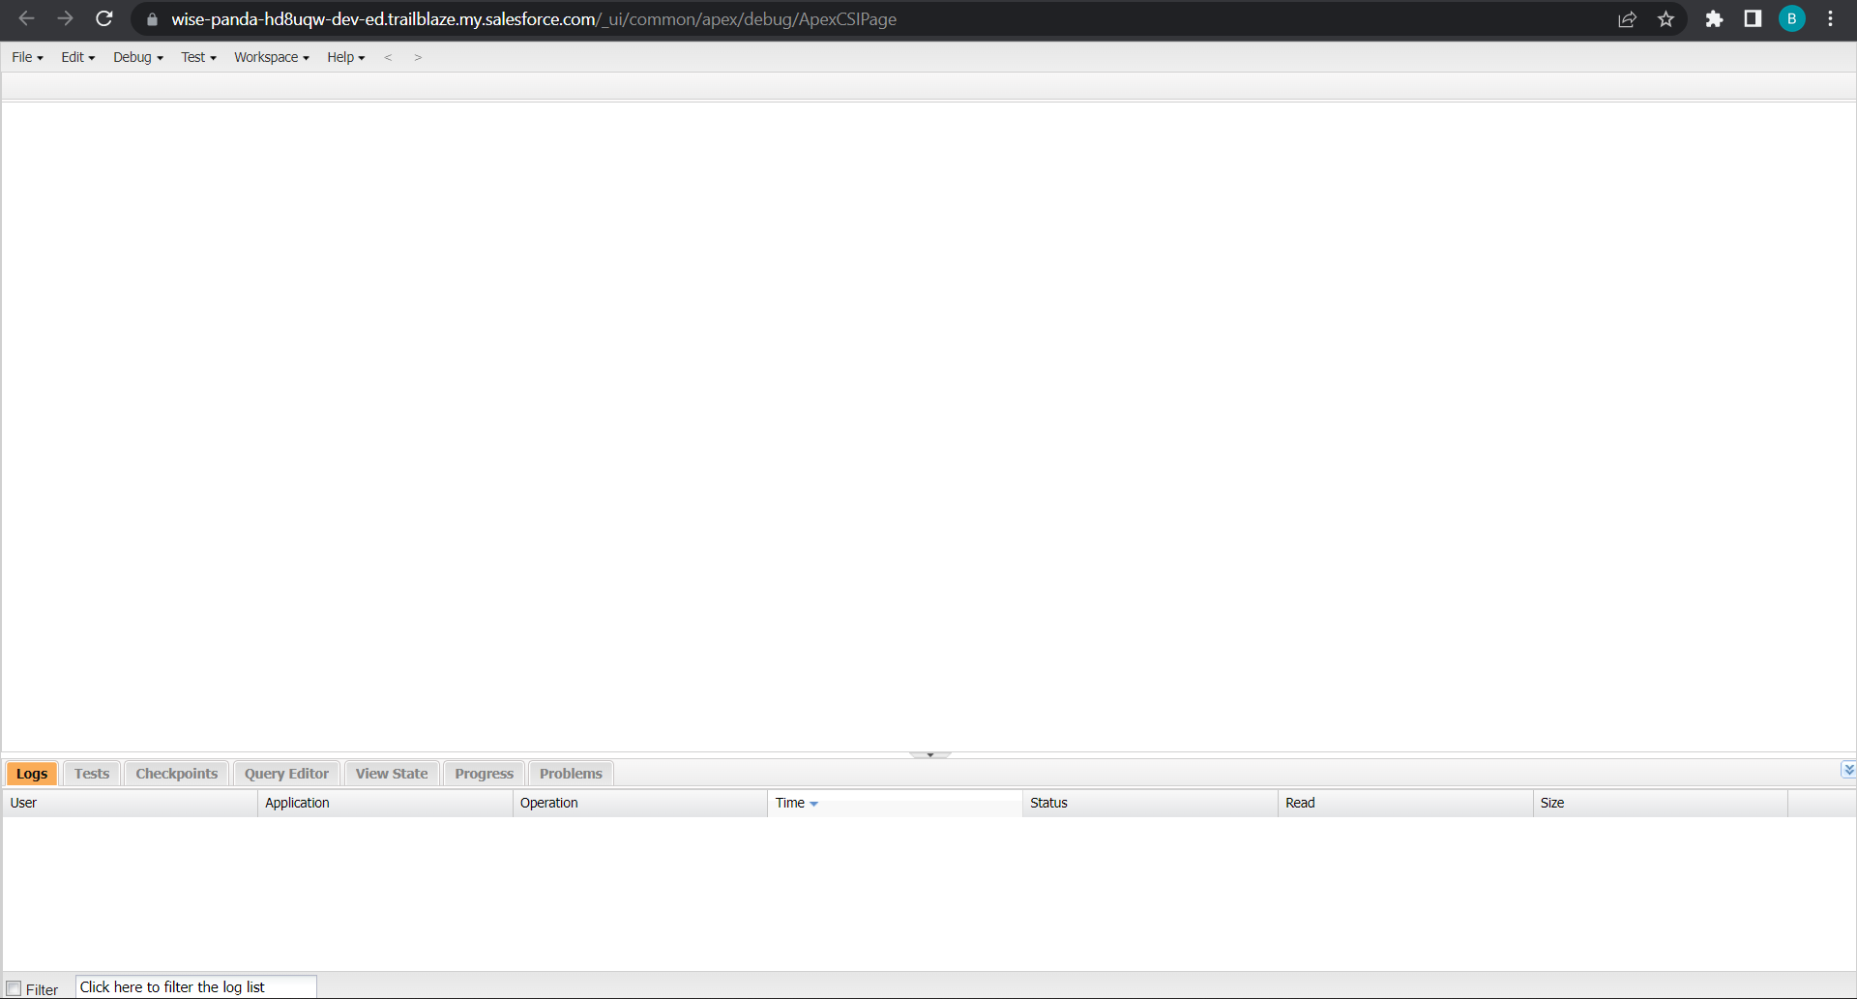
Exercise - 02 Use Execute Anonymous to define and execute the following code: Developer Console
Notes:
Key Messages
- Helps our customers deliver a unified customer experience by making our products for B2C Service and Commerce and multiple Service Cloud orgs work together more seamlessly.
- Gives Admins a central place and a click based UI to build connectivity across the apps in a trusted and secure environment
- Builds an ID that is the foundation of connected experiences
- Powers cross-channel experiences that are delivered in pre-built packages in Service and Commerce
- Custom experiences can be built to connect multiple orgs. in Lightning Platform around individual contacts or person accounts
Talk Track
Customer 360 Data Manager gives you one place to centrally establish trusted, secure connectivity across your Salesforce applications. We’re doing away with point to point connectivity and giving you a central hub with a click based UI to manage how apps connect and the data management tools necessary to power connected experience. In the Customer 360 Data Manager you’ll find a robust set of functionality that takes data from the connected systems and creates a single ID for individuals and an accurate, up to date Contact Profile. With point and click ease, Admins will enable new, cross-channel experiences like surfacing data right from Commerce Cloud B2C into an Agent Console in Service Cloud.

Slide 35
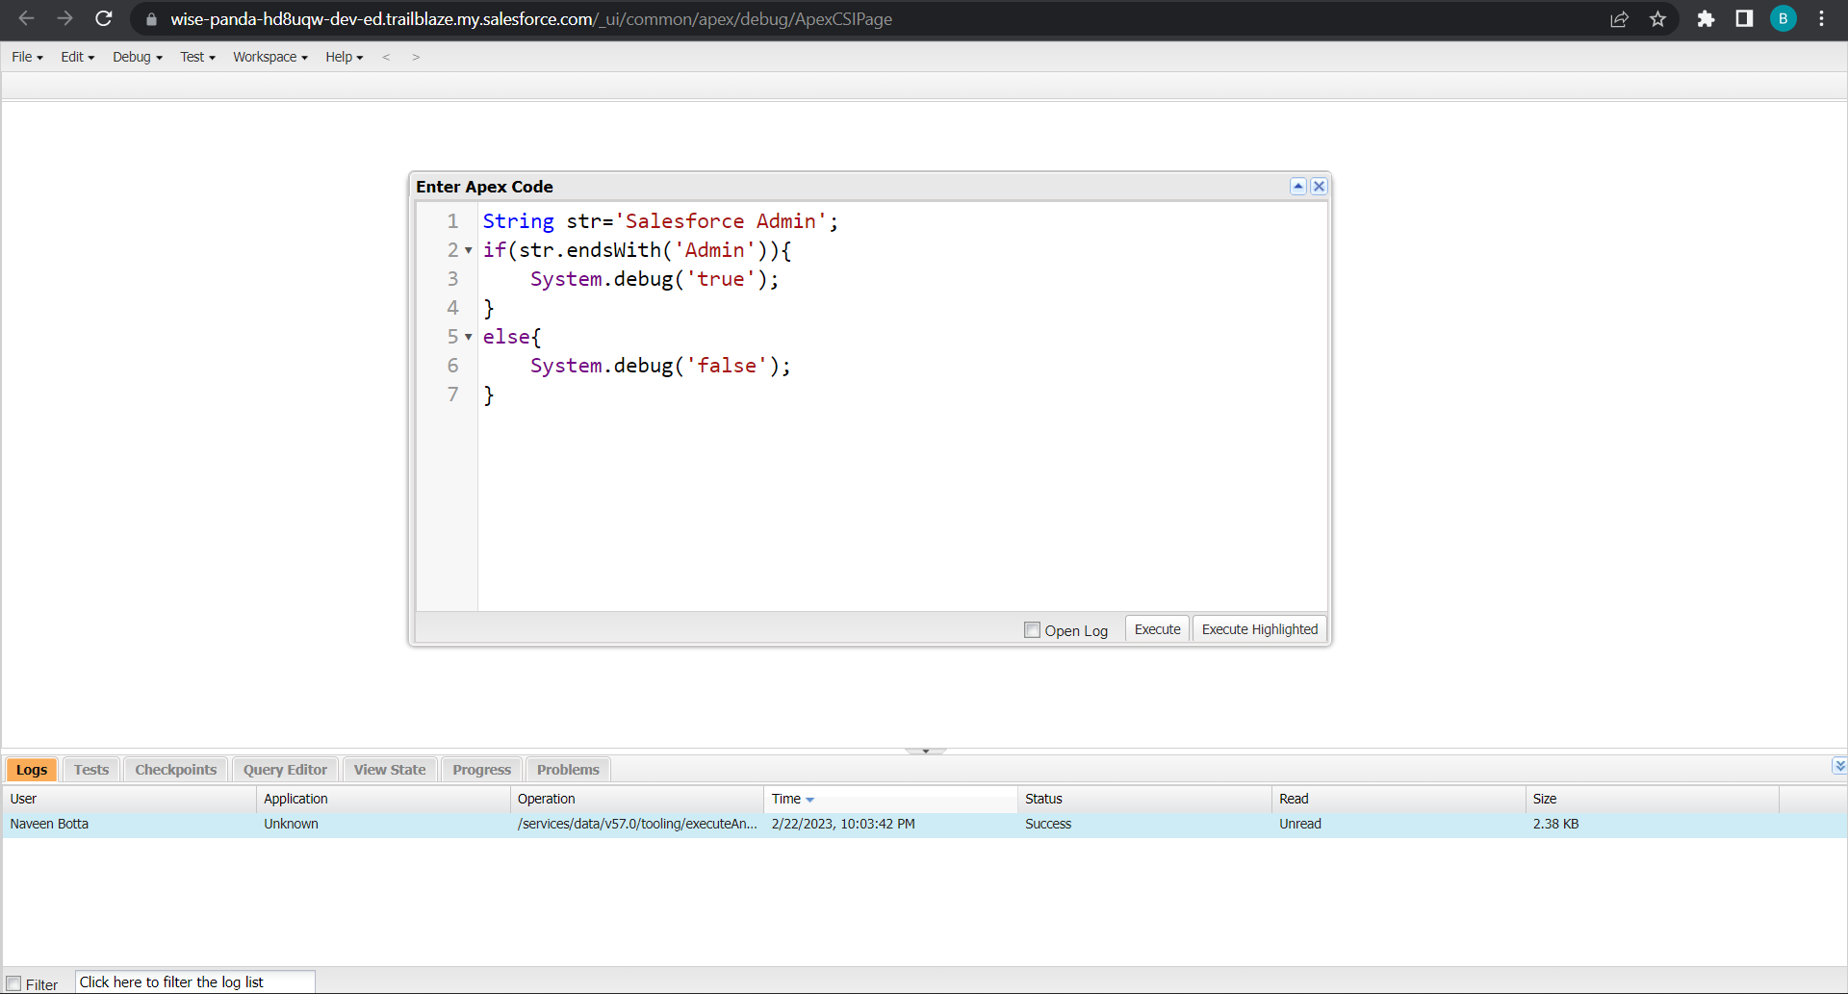
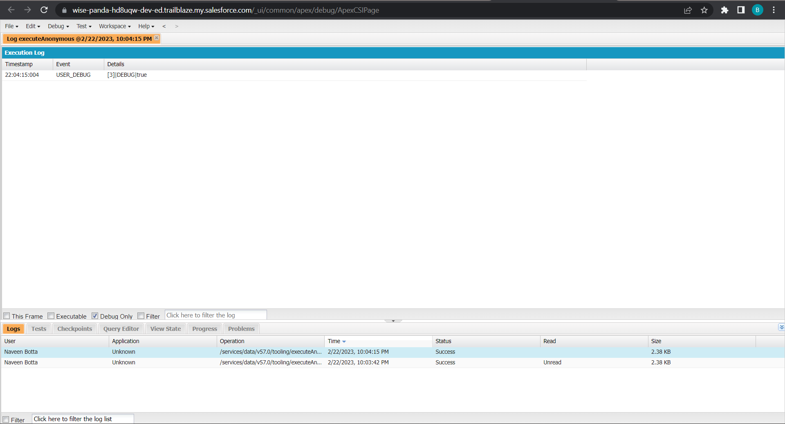
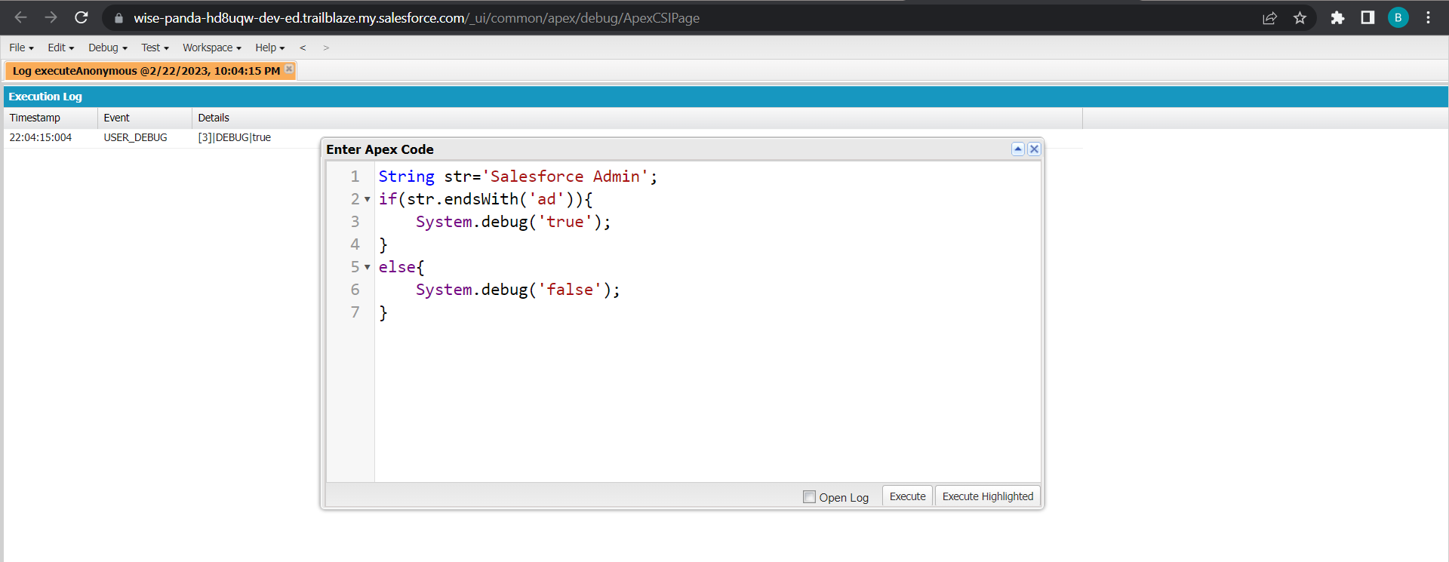
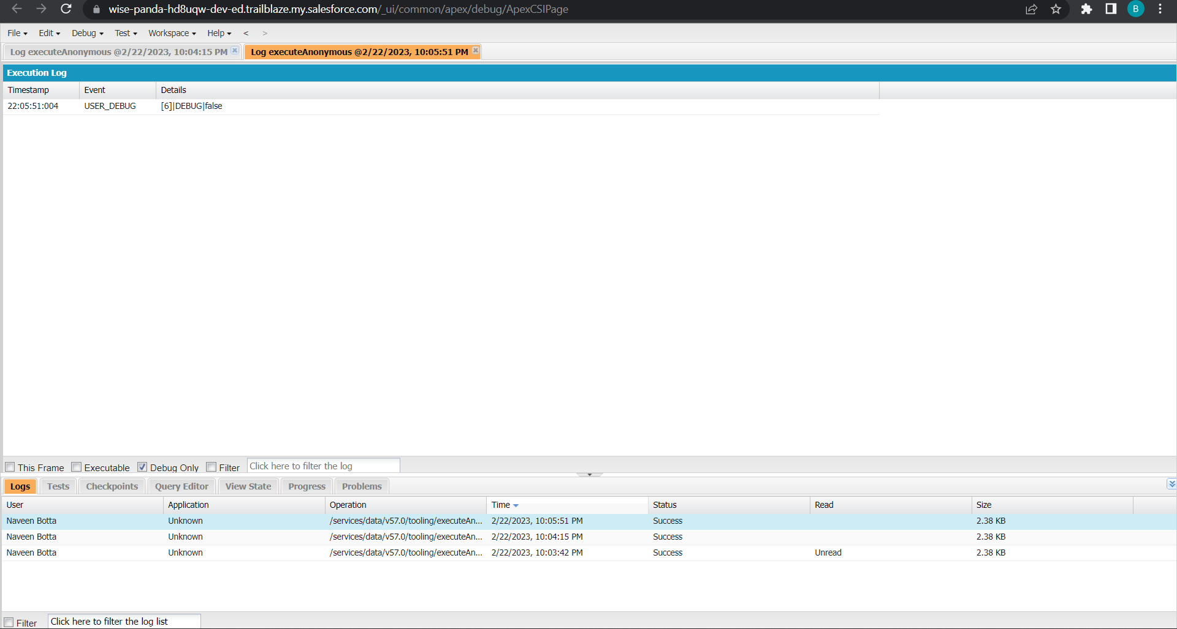
1.Define a String Variable & use string method ‘endsWith’ to display the output. By clicking oh Debug and select open Anonymous window
Notes:
Key Messages
Designed to be Application Agnostic allowing multiple data systems to be mapped to it. Map individual systems to the CIM
Subject Areas for the data model are related to an individual. The party – Account & Contact, Payment, Method, Products, Sales Order and Shipment
The CIM covers the subjects
Open Source – Owned by the Linux Foundation – The model is not controlled by just one company

Slide 36
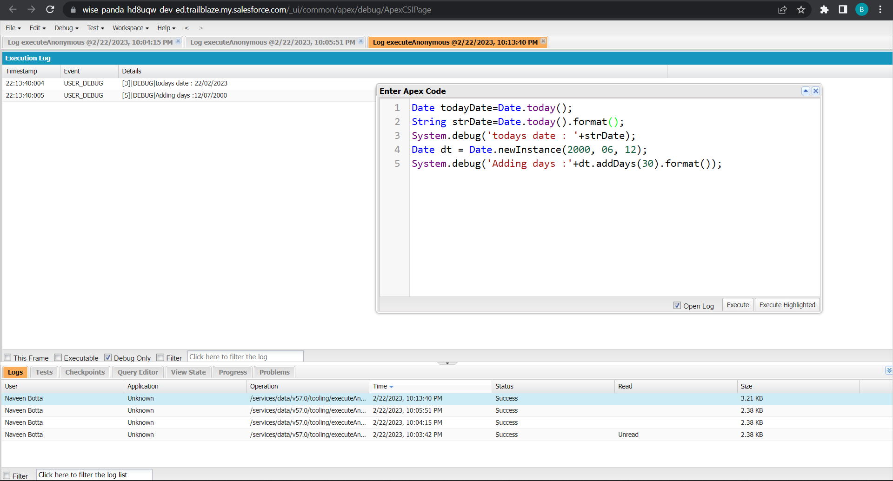
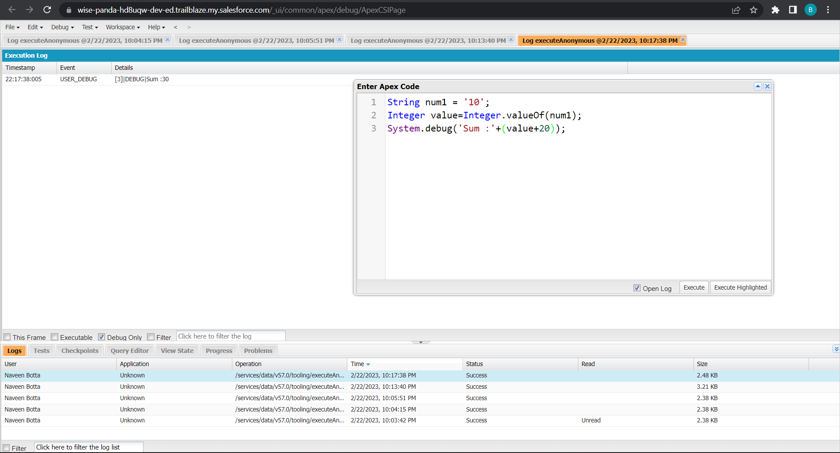
3. Display the output of an Integer variable from string ‘10’ and then add 20 to it.
2. Define 2 Date type variables, use Date method today() & addDays(30) to display the output
Notes:
Key Messages
Designed to be Application Agnostic allowing multiple data systems to be mapped to it. Map individual systems to the CIM
Subject Areas for the data model are related to an individual. The party – Account & Contact, Payment, Method, Products, Sales Order and Shipment
The CIM covers the subjects
Open Source – Owned by the Linux Foundation – The model is not controlled by just one company

Slide 37
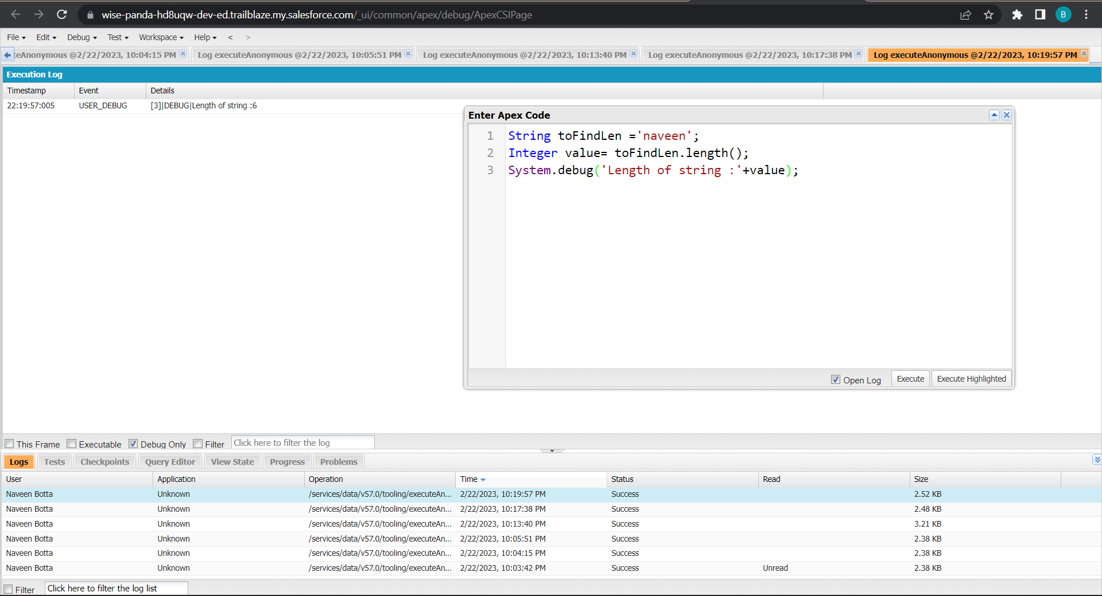
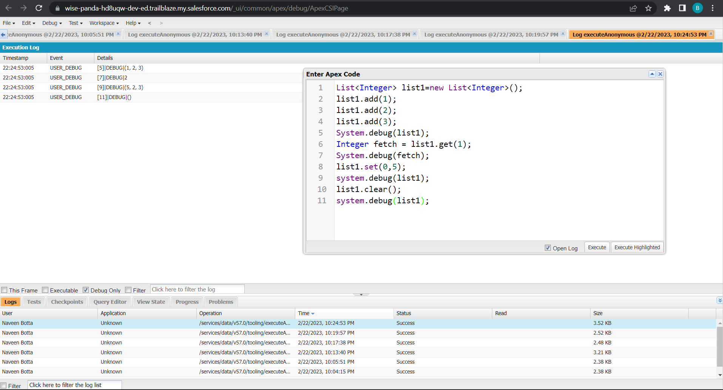
5. Define a List of integer and display the output using add(), get(), set(), clear(), methods.
4. Define a String Variable & use string method length() to display the output
Notes:
Key Messages
- Helps our customers deliver a unified customer experience by making our products for B2C Service and Commerce and multiple Service Cloud orgs work together more seamlessly.
- Gives Admins a central place and a click based UI to build connectivity across the apps in a trusted and secure environment
- Builds an ID that is the foundation of connected experiences
- Powers cross-channel experiences that are delivered in pre-built packages in Service and Commerce
- Custom experiences can be built to connect multiple orgs. in Lightning Platform around individual contacts or person accounts
Talk Track
Customer 360 Data Manager gives you one place to centrally establish trusted, secure connectivity across your Salesforce applications. We’re doing away with point to point connectivity and giving you a central hub with a click based UI to manage how apps connect and the data management tools necessary to power connected experience. In the Customer 360 Data Manager you’ll find a robust set of functionality that takes data from the connected systems and creates a single ID for individuals and an accurate, up to date Contact Profile. With point and click ease, Admins will enable new, cross-channel experiences like surfacing data right from Commerce Cloud B2C into an Agent Console in Service Cloud.

Slide 38
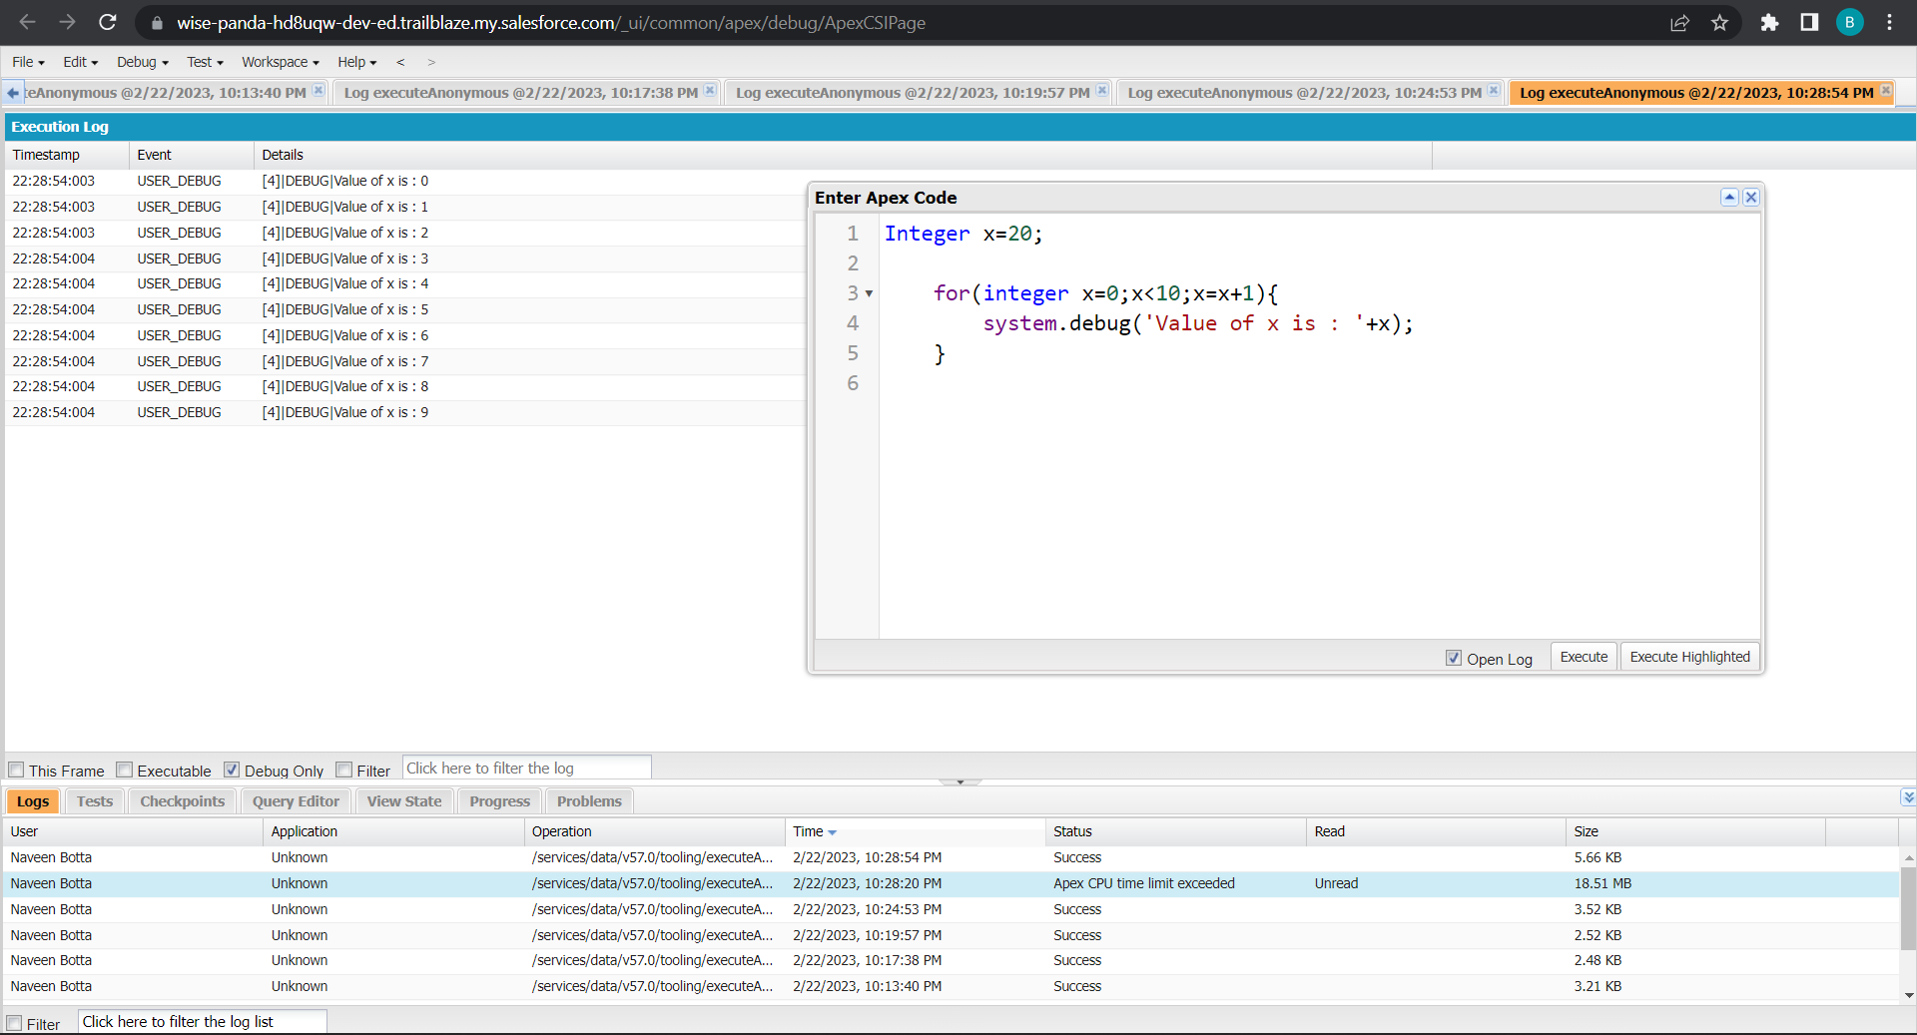
Use Execute Anonymous to define and execute the following code to display the value of x = 0 to 9.
Notes:
Key Messages
- Helps our customers deliver a unified customer experience by making our products for B2C Service and Commerce and multiple Service Cloud orgs work together more seamlessly.
- Gives Admins a central place and a click based UI to build connectivity across the apps in a trusted and secure environment
- Builds an ID that is the foundation of connected experiences
- Powers cross-channel experiences that are delivered in pre-built packages in Service and Commerce
- Custom experiences can be built to connect multiple orgs. in Lightning Platform around individual contacts or person accounts
Talk Track
Customer 360 Data Manager gives you one place to centrally establish trusted, secure connectivity across your Salesforce applications. We’re doing away with point to point connectivity and giving you a central hub with a click based UI to manage how apps connect and the data management tools necessary to power connected experience. In the Customer 360 Data Manager you’ll find a robust set of functionality that takes data from the connected systems and creates a single ID for individuals and an accurate, up to date Contact Profile. With point and click ease, Admins will enable new, cross-channel experiences like surfacing data right from Commerce Cloud B2C into an Agent Console in Service Cloud.

Slide 39
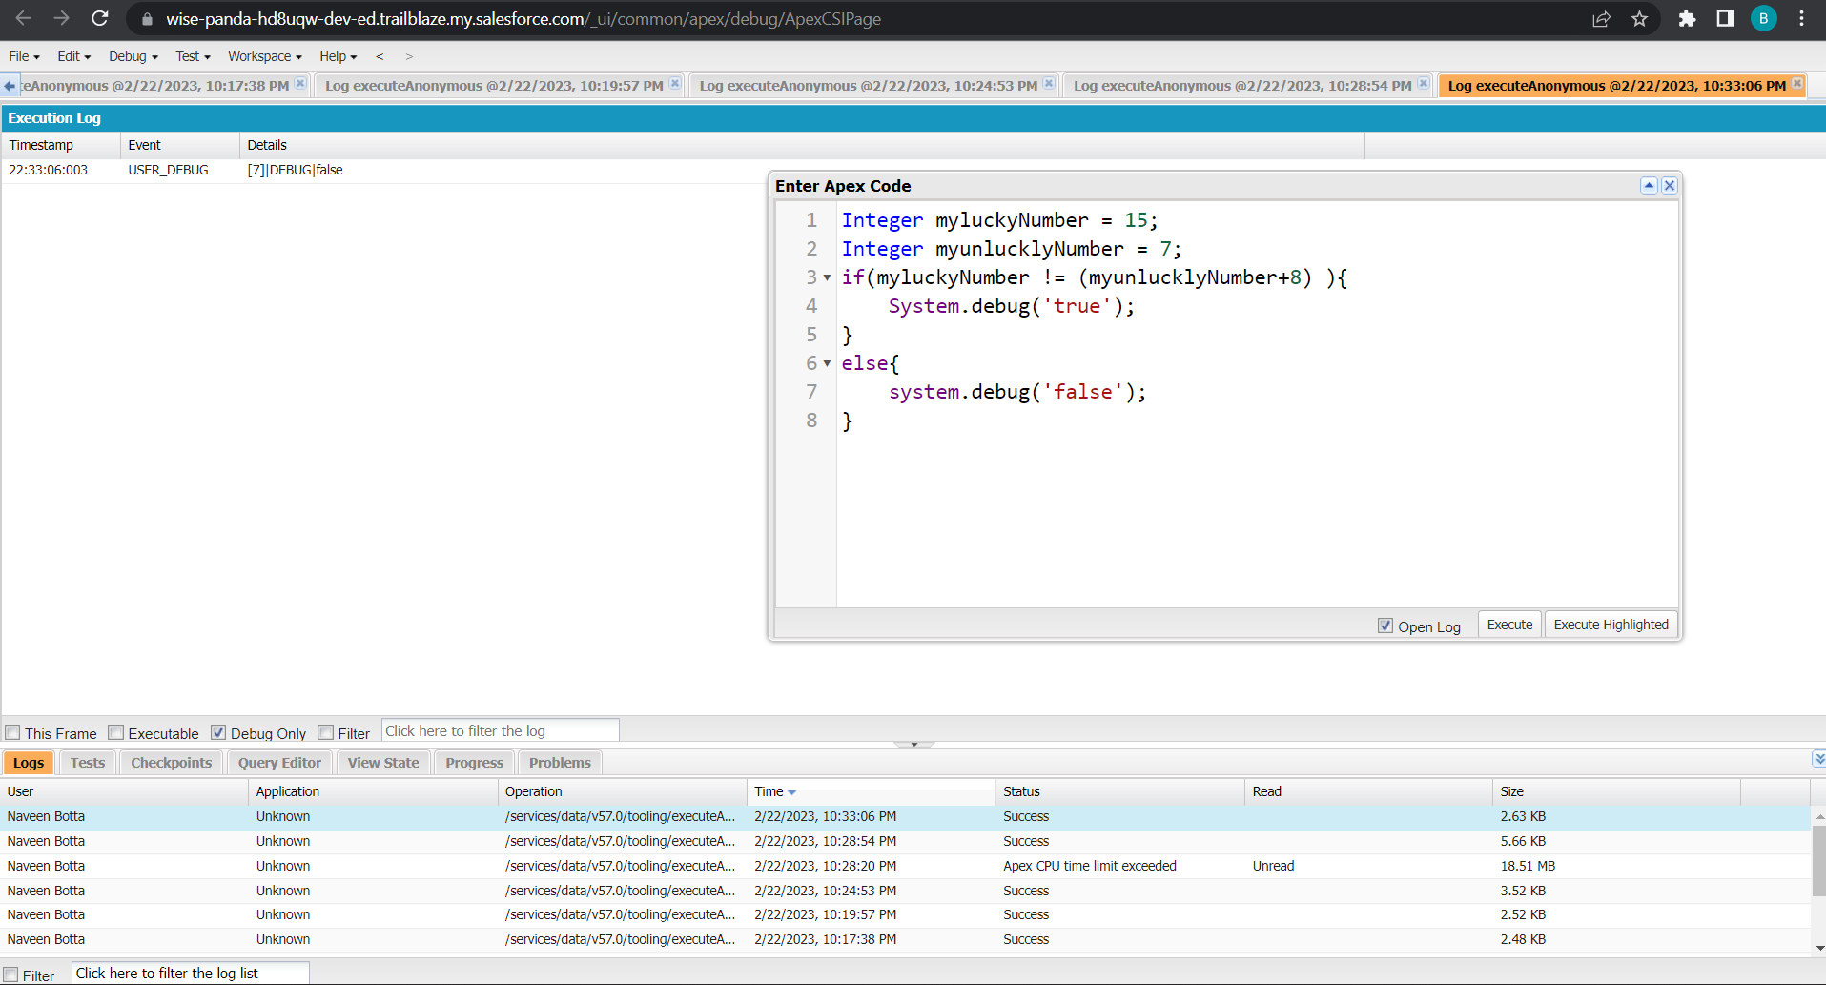
Exercise 3 Answer the following in True or False: Integer myunlucklyNumber = 7; Integer myluckyNumber = 15; myluckyNumber != myunlucklyNumber + 8.
Notes:
Key Messages
Designed to be Application Agnostic allowing multiple data systems to be mapped to it. Map individual systems to the CIM
Subject Areas for the data model are related to an individual. The party – Account & Contact, Payment, Method, Products, Sales Order and Shipment
The CIM covers the subjects
Open Source – Owned by the Linux Foundation – The model is not controlled by just one company

Slide 40
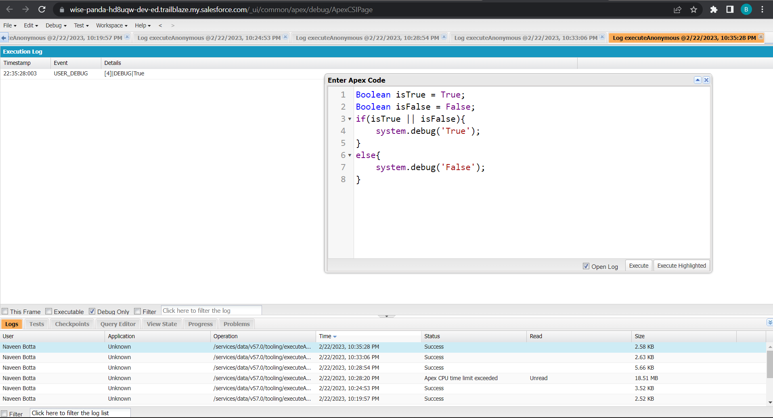
Exercise 4 Answer the following in True Or False: Boolean isFalse = false; Boolean isTrue = True; isTrue || isFalse Boolean isTrue = true;
Notes:
Key Messages
Designed to be Application Agnostic allowing multiple data systems to be mapped to it. Map individual systems to the CIM
Subject Areas for the data model are related to an individual. The party – Account & Contact, Payment, Method, Products, Sales Order and Shipment
The CIM covers the subjects
Open Source – Owned by the Linux Foundation – The model is not controlled by just one company

Slide 41

Exercise 5 Answer the following in True Or False: Date tomorrow = Date.today().addDays(1); Date today = Date.today(); today != tomorrow
Notes:
Key Messages
- Helps our customers deliver a unified customer experience by making our products for B2C Service and Commerce and multiple Service Cloud orgs work together more seamlessly.
- Gives Admins a central place and a click based UI to build connectivity across the apps in a trusted and secure environment
- Builds an ID that is the foundation of connected experiences
- Powers cross-channel experiences that are delivered in pre-built packages in Service and Commerce
- Custom experiences can be built to connect multiple orgs. in Lightning Platform around individual contacts or person accounts
Talk Track
Customer 360 Data Manager gives you one place to centrally establish trusted, secure connectivity across your Salesforce applications. We’re doing away with point to point connectivity and giving you a central hub with a click based UI to manage how apps connect and the data management tools necessary to power connected experience. In the Customer 360 Data Manager you’ll find a robust set of functionality that takes data from the connected systems and creates a single ID for individuals and an accurate, up to date Contact Profile. With point and click ease, Admins will enable new, cross-channel experiences like surfacing data right from Commerce Cloud B2C into an Agent Console in Service Cloud.

Slide 42

Exercise 6 Write a program and execute to demo the use of “If..else if...else”
Notes:
Key Messages
- Helps our customers deliver a unified customer experience by making our products for B2C Service and Commerce and multiple Service Cloud orgs work together more seamlessly.
- Gives Admins a central place and a click based UI to build connectivity across the apps in a trusted and secure environment
- Builds an ID that is the foundation of connected experiences
- Powers cross-channel experiences that are delivered in pre-built packages in Service and Commerce
- Custom experiences can be built to connect multiple orgs. in Lightning Platform around individual contacts or person accounts
Talk Track
Customer 360 Data Manager gives you one place to centrally establish trusted, secure connectivity across your Salesforce applications. We’re doing away with point to point connectivity and giving you a central hub with a click based UI to manage how apps connect and the data management tools necessary to power connected experience. In the Customer 360 Data Manager you’ll find a robust set of functionality that takes data from the connected systems and creates a single ID for individuals and an accurate, up to date Contact Profile. With point and click ease, Admins will enable new, cross-channel experiences like surfacing data right from Commerce Cloud B2C into an Agent Console in Service Cloud.

Slide 43


Exercise 7 Write a program to execute and demo the use of “Apex – for Loop”
Notes:
Key Messages
Designed to be Application Agnostic allowing multiple data systems to be mapped to it. Map individual systems to the CIM
Subject Areas for the data model are related to an individual. The party – Account & Contact, Payment, Method, Products, Sales Order and Shipment
The CIM covers the subjects
Open Source – Owned by the Linux Foundation – The model is not controlled by just one company

Slide 44


Exercise 8 Write a Class to demo the use of Constants in Apex
Notes:
Key Messages
Designed to be Application Agnostic allowing multiple data systems to be mapped to it. Map individual systems to the CIM
Subject Areas for the data model are related to an individual. The party – Account & Contact, Payment, Method, Products, Sales Order and Shipment
The CIM covers the subjects
Open Source – Owned by the Linux Foundation – The model is not controlled by just one company

Slide 45

Exercise 9 Write a Class to demo the use of Interface in Apex
Notes:
Key Messages
- Helps our customers deliver a unified customer experience by making our products for B2C Service and Commerce and multiple Service Cloud orgs work together more seamlessly.
- Gives Admins a central place and a click based UI to build connectivity across the apps in a trusted and secure environment
- Builds an ID that is the foundation of connected experiences
- Powers cross-channel experiences that are delivered in pre-built packages in Service and Commerce
- Custom experiences can be built to connect multiple orgs. in Lightning Platform around individual contacts or person accounts
Talk Track
Customer 360 Data Manager gives you one place to centrally establish trusted, secure connectivity across your Salesforce applications. We’re doing away with point to point connectivity and giving you a central hub with a click based UI to manage how apps connect and the data management tools necessary to power connected experience. In the Customer 360 Data Manager you’ll find a robust set of functionality that takes data from the connected systems and creates a single ID for individuals and an accurate, up to date Contact Profile. With point and click ease, Admins will enable new, cross-channel experiences like surfacing data right from Commerce Cloud B2C into an Agent Console in Service Cloud.

Slide 46


Exercise 10 Demo on DML Insert Operation Using Database methods 1.Insert a Customer Record First using simple DML Statement
Notes:
Key Messages
- Helps our customers deliver a unified customer experience by making our products for B2C Service and Commerce and multiple Service Cloud orgs work together more seamlessly.
- Gives Admins a central place and a click based UI to build connectivity across the apps in a trusted and secure environment
- Builds an ID that is the foundation of connected experiences
- Powers cross-channel experiences that are delivered in pre-built packages in Service and Commerce
- Custom experiences can be built to connect multiple orgs. in Lightning Platform around individual contacts or person accounts
Talk Track
Customer 360 Data Manager gives you one place to centrally establish trusted, secure connectivity across your Salesforce applications. We’re doing away with point to point connectivity and giving you a central hub with a click based UI to manage how apps connect and the data management tools necessary to power connected experience. In the Customer 360 Data Manager you’ll find a robust set of functionality that takes data from the connected systems and creates a single ID for individuals and an accurate, up to date Contact Profile. With point and click ease, Admins will enable new, cross-channel experiences like surfacing data right from Commerce Cloud B2C into an Agent Console in Service Cloud.

Slide 47


2. Insert Billing record using Database methods. Here use record id to insert customer
Notes:
Key Messages
Designed to be Application Agnostic allowing multiple data systems to be mapped to it. Map individual systems to the CIM
Subject Areas for the data model are related to an individual. The party – Account & Contact, Payment, Method, Products, Sales Order and Shipment
The CIM covers the subjects
Open Source – Owned by the Linux Foundation – The model is not controlled by just one company

Slide 48

Exercise 11 Write and execute SOQL queries from Developer Console Display ID, Amount, Stage, Account Name, Account Industry, Account Website From Opportunity AND “Account Annual Revenue > 5000” Add a Where Clause “Account Industry = Energy”
Notes:
Key Messages
- Helps our customers deliver a unified customer experience by making our products for B2C Service and Commerce and multiple Service Cloud orgs work together more seamlessly.
- Gives Admins a central place and a click based UI to build connectivity across the apps in a trusted and secure environment
- Builds an ID that is the foundation of connected experiences
- Powers cross-channel experiences that are delivered in pre-built packages in Service and Commerce
- Custom experiences can be built to connect multiple orgs. in Lightning Platform around individual contacts or person accounts
Talk Track
Customer 360 Data Manager gives you one place to centrally establish trusted, secure connectivity across your Salesforce applications. We’re doing away with point to point connectivity and giving you a central hub with a click based UI to manage how apps connect and the data management tools necessary to power connected experience. In the Customer 360 Data Manager you’ll find a robust set of functionality that takes data from the connected systems and creates a single ID for individuals and an accurate, up to date Contact Profile. With point and click ease, Admins will enable new, cross-channel experiences like surfacing data right from Commerce Cloud B2C into an Agent Console in Service Cloud.

Slide 49


Exercise 12 Write an Apex Trigger, Name = CustomerTrigger. Create a Billing Record when on Customer Object the 'Status' field changes to Active from Inactive. Billing “Status” must be: Paid, Amount Paid = 1000000 Perform the DML on a List.
Notes:
Key Messages
- Helps our customers deliver a unified customer experience by making our products for B2C Service and Commerce and multiple Service Cloud orgs work together more seamlessly.
- Gives Admins a central place and a click based UI to build connectivity across the apps in a trusted and secure environment
- Builds an ID that is the foundation of connected experiences
- Powers cross-channel experiences that are delivered in pre-built packages in Service and Commerce
- Custom experiences can be built to connect multiple orgs. in Lightning Platform around individual contacts or person accounts
Talk Track
Customer 360 Data Manager gives you one place to centrally establish trusted, secure connectivity across your Salesforce applications. We’re doing away with point to point connectivity and giving you a central hub with a click based UI to manage how apps connect and the data management tools necessary to power connected experience. In the Customer 360 Data Manager you’ll find a robust set of functionality that takes data from the connected systems and creates a single ID for individuals and an accurate, up to date Contact Profile. With point and click ease, Admins will enable new, cross-channel experiences like surfacing data right from Commerce Cloud B2C into an Agent Console in Service Cloud.

Slide 50

Exercise 13 Write a Test Class for CustomerTrigger. Create the Data for the Customer custom Object Use Test.startTest() & Test.stopTest(). Use assert statement to validate the output, Test Class must have full code coverage.
Notes:
Key Messages
- Helps our customers deliver a unified customer experience by making our products for B2C Service and Commerce and multiple Service Cloud orgs work together more seamlessly.
- Gives Admins a central place and a click based UI to build connectivity across the apps in a trusted and secure environment
- Builds an ID that is the foundation of connected experiences
- Powers cross-channel experiences that are delivered in pre-built packages in Service and Commerce
- Custom experiences can be built to connect multiple orgs. in Lightning Platform around individual contacts or person accounts
Talk Track
Customer 360 Data Manager gives you one place to centrally establish trusted, secure connectivity across your Salesforce applications. We’re doing away with point to point connectivity and giving you a central hub with a click based UI to manage how apps connect and the data management tools necessary to power connected experience. In the Customer 360 Data Manager you’ll find a robust set of functionality that takes data from the connected systems and creates a single ID for individuals and an accurate, up to date Contact Profile. With point and click ease, Admins will enable new, cross-channel experiences like surfacing data right from Commerce Cloud B2C into an Agent Console in Service Cloud.

Slide 51


Exercise 14 Exercise 15
Notes:
Key Messages
Designed to be Application Agnostic allowing multiple data systems to be mapped to it. Map individual systems to the CIM
Subject Areas for the data model are related to an individual. The party – Account & Contact, Payment, Method, Products, Sales Order and Shipment
The CIM covers the subjects
Open Source – Owned by the Linux Foundation – The model is not controlled by just one company

Slide 52


Exercise 16 Create a Visualforce page which displays Opportunity fields as output fields.
Notes:
Key Messages
Designed to be Application Agnostic allowing multiple data systems to be mapped to it. Map individual systems to the CIM
Subject Areas for the data model are related to an individual. The party – Account & Contact, Payment, Method, Products, Sales Order and Shipment
The CIM covers the subjects
Open Source – Owned by the Linux Foundation – The model is not controlled by just one company

Slide 53


Exercise 17 Create a Visualforce page which shows a list of Accounts linked to their record pages
Notes:
Key Messages
Designed to be Application Agnostic allowing multiple data systems to be mapped to it. Map individual systems to the CIM
Subject Areas for the data model are related to an individual. The party – Account & Contact, Payment, Method, Products, Sales Order and Shipment
The CIM covers the subjects
Open Source – Owned by the Linux Foundation – The model is not controlled by just one company

Slide 54



Exercise 18 Create a Visualforce page that uses a custom controller to display a list of cases with the status of 'New'. The page must be named NewCaseList.
Notes:
Key Messages
- Helps our customers deliver a unified customer experience by making our products for B2C Service and Commerce and multiple Service Cloud orgs work together more seamlessly.
- Gives Admins a central place and a click based UI to build connectivity across the apps in a trusted and secure environment
- Builds an ID that is the foundation of connected experiences
- Powers cross-channel experiences that are delivered in pre-built packages in Service and Commerce
- Custom experiences can be built to connect multiple orgs. in Lightning Platform around individual contacts or person accounts
Talk Track
Customer 360 Data Manager gives you one place to centrally establish trusted, secure connectivity across your Salesforce applications. We’re doing away with point to point connectivity and giving you a central hub with a click based UI to manage how apps connect and the data management tools necessary to power connected experience. In the Customer 360 Data Manager you’ll find a robust set of functionality that takes data from the connected systems and creates a single ID for individuals and an accurate, up to date Contact Profile. With point and click ease, Admins will enable new, cross-channel experiences like surfacing data right from Commerce Cloud B2C into an Agent Console in Service Cloud.

